Slide 1
Update
Chris Woodfield, ARIN Advisory Council

Slide 2
Mission Statement
“ARIN, a nonprofit member-based organization, supports the operation of the Internet through the management of Internet number resources throughout its service region; coordinates the development of policies by the community for the management of Internet Protocol number resources; and advances the Internet through informational outreach.”

Slide 3
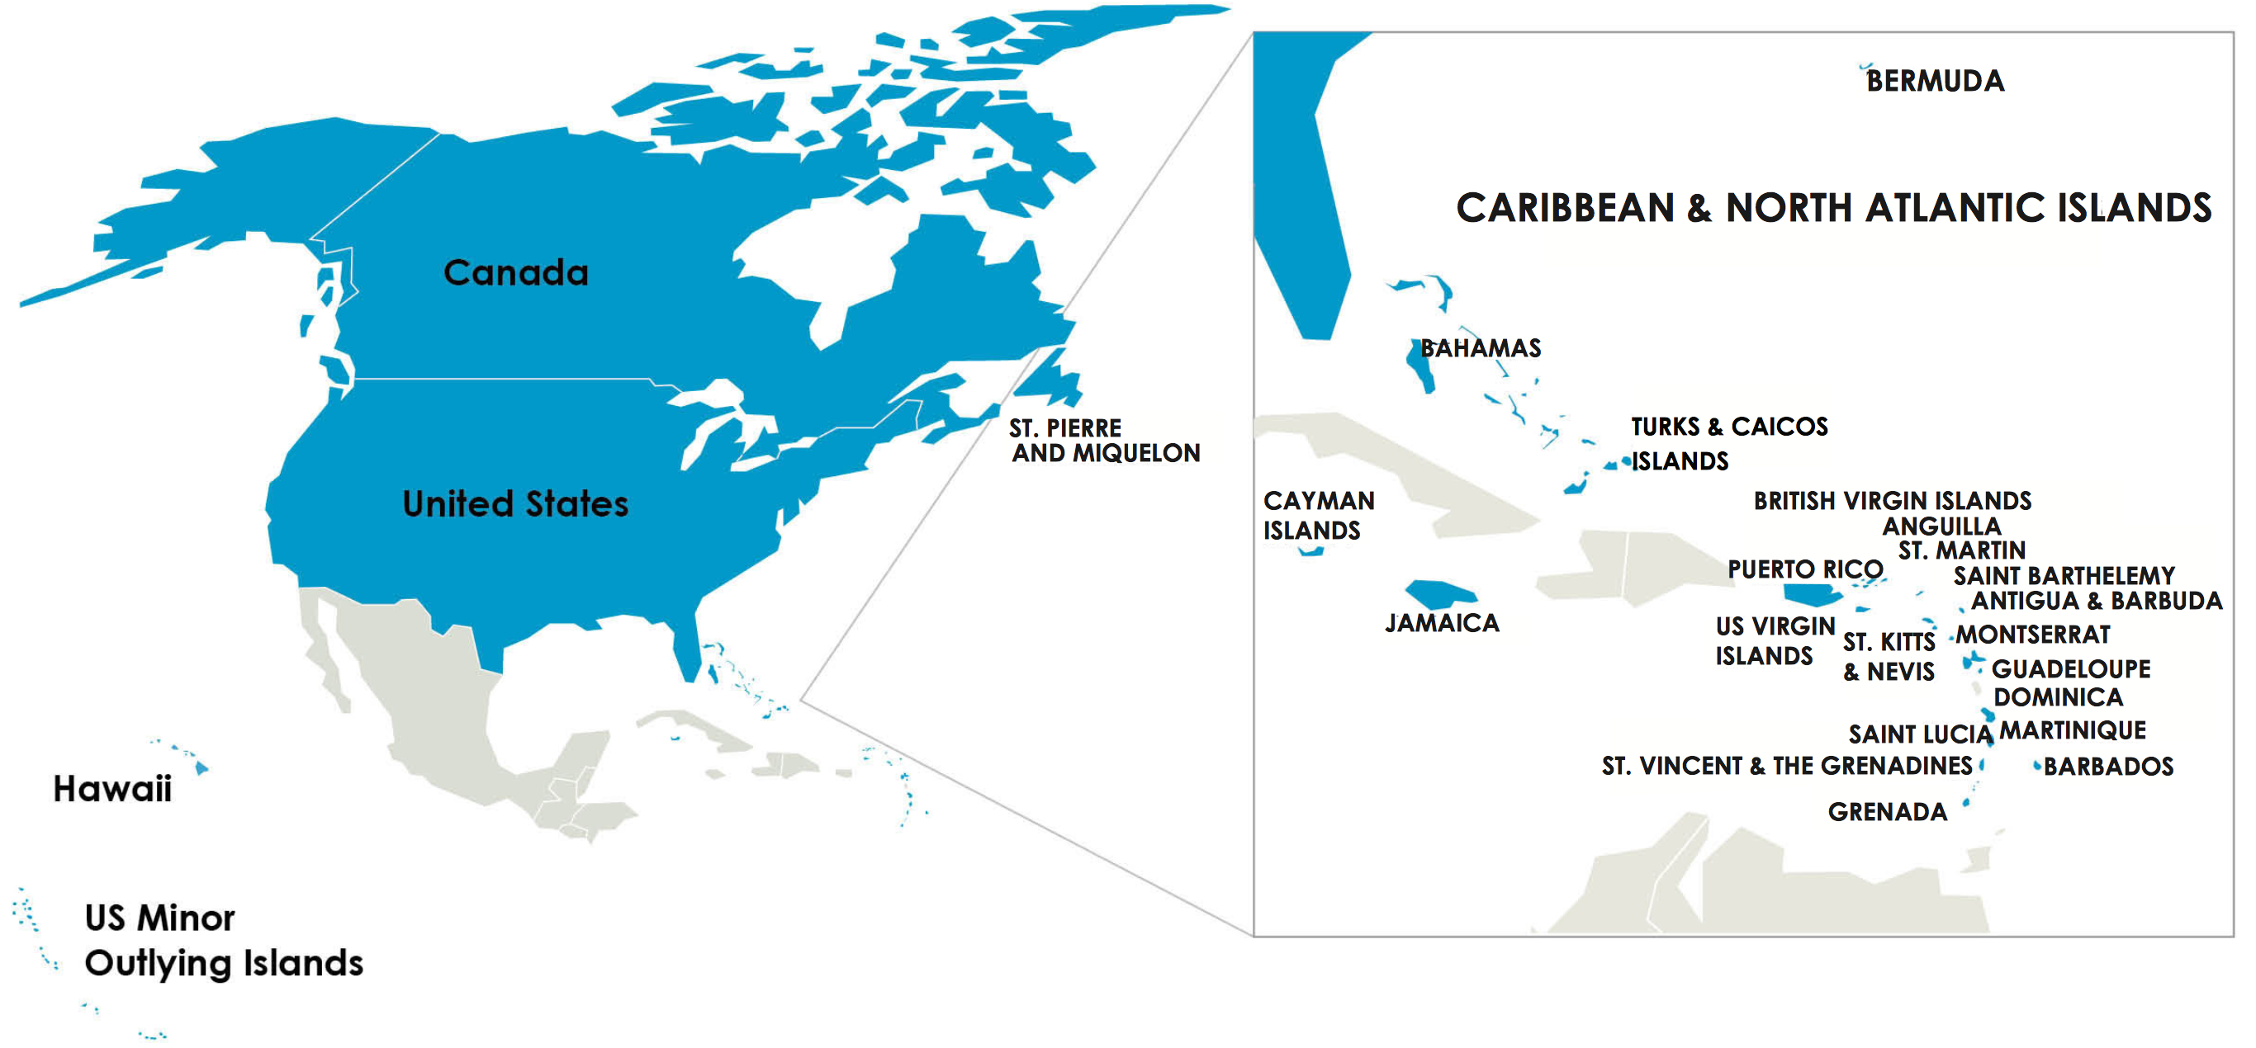
ARIN Serves…
The United States
Canada
25+ Caribbean &
North Atlantic
economies
Served Organizations: 38,442
(22,677 Under Contract, 6,187 Members, 15,765 Legacy)

Slide 4
Community Engagement
ARIN on the Road/ARIN in the Caribbean
Customer lunches
Participation in national and regional Internet coordination & governance fora
Outreach and training for government, law enforcement, etc.
Support a very active community consultation and suggestion process
ARIN Bits (our quarterly e-news update)

Slide 5
Our Focus
Uphold the multi-stakeholder model for management of Internet number resources
Educate the community about ongoing IPv6 adoption and emerging technologies
Maintain, develop, and enhance functionality of ARIN services as sought by the users and supported by the membership
Coordinate globally to maintain a consistent and highly usable Internet Numbers Registry system

Slide 6
Caribbean Engagement
Major focus on Caribbean Internet development
Facilitating participation with ARIN across a range of areas (Policy Development Discussions, Outreach, Capacity Building)
Continuing Collaboration with:
  Caribbean Telecommunications Union (CTU)
  CaribNOG
  Caribbean Internet Governance Forum
  CANTO
Notes:
We have in the past struggled to engage the Caribbean community, but we are making great strides in increasing representation; we now have one Board Of Trustees member and two members of the Advisory Council who are based in the Caribbean. This representation is helping us with outreach and bringing attention to issues specific to organizations in the region that may have otherwise gone unaddressed.

Slide 7
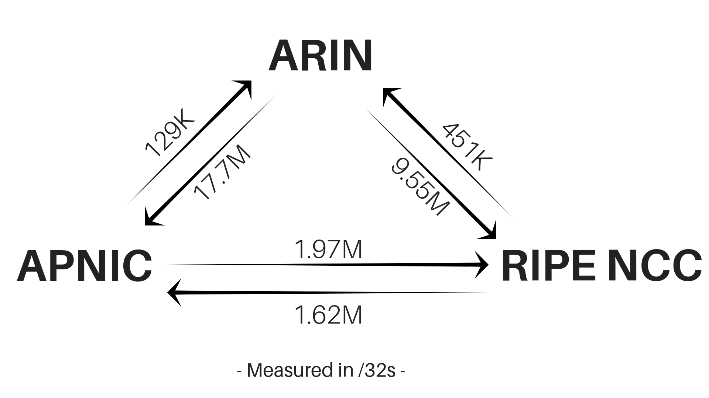
Inter-RIR Transfers

Slide 8
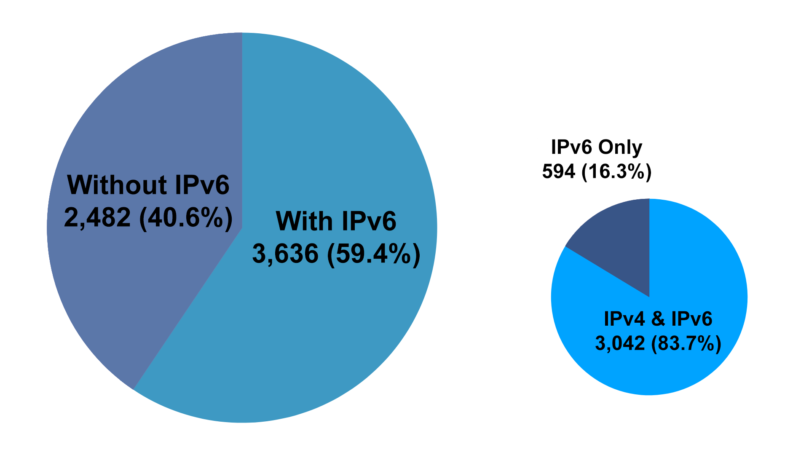
Member IPv6 Holdings

Slide 9
Recently Adopted Policies
ARIN-2017-12: POC Notification and Validation Upon Reassignment or Reallocation
ARIN-2018-5: Disallow Third-party Organization Record Creation
Pending implementation in Q1 2020
Notes:
Both of these are intended to reduce the number of “drive-by” POC records, where POC records are created for customers by upstream providers or other third parties, often without the POC’s knowledge and often identifying incorrect POCs (such as a purchasing manager).

Slide 10
Recommended Draft Policies
ARIN-2018-6: Clarify Reassignment Requirements in 4.2.3.7.1
ARIN-2019-1: Clarify Section 4 IPv4 Request Requirements
ARIN-2019-3: Update 4.10 – IPv6 Deployment Block
ARIN-2019-8: Clarification of Section 4.10 for Multiple Discrete Networks
ARIN-2019-10: Inter-RIR M&A
ARIN-2019-15: Hijacking Authorization Not-intended
Notes:
2018-6: Intended to reduce the need for detailed reassignments (and as a result cut down on unnecessary POC records)
2019-1: My own proposal: A technical clarification on waiting periods, and language intended to reduce churn (you can’t sell an address block and then join the waiting list for more)
2019-3: Raises minimum IPv6 deployment block allocation to /24, limits number of these blocks one org can receive
2019-8: Allows IPv6 deployment allocations to be requested in parallel for multiple discrete networks, up to a /21 every six months.
2019-10: Allows resource holder to “move” to another region – must follow a bona fide change of venue (relocation, M&A by foreign entity followed by a winding-down of ARIN-region operations)
2019-15

Slide 11
Draft Policies Under Discussion
ARIN-2019-12: M&A Legal Jurisdiction Exclusion
ARIN-2019-13: ARIN Membership Legal Jurisdiction Exclusion
ARIN-2019-17: Returned Addresses to the 4.10 Reserved Pool
Notes:
2019-12: Almost the opposite of 2019-10; allows a non-ARIN entity to hold ARIN resources if the entity acquires resources from an ARIN entity via M&A.
2019-13 : Allows a non-ARIN region entity to hold ARIN resources directly, even if not via M&A.
2019-17: Effectively abolishes the waiting list, specifying that resources returned to ARIN should be distributed via the 4.10 reserved pool allocation process instead.

Slide 12
Other News
Website redesign launched in March
  Continual, iterative improvements being made based on user feedback
ARIN Community Grant Program Inaugural Year
  Awarded grants to four projects that are aimed at improving the overall Internet industry and Internet user environment
Work on new Internet Routing Registry (IRR) in progress
IPv4 waiting list allocations are no longer suspended – the best time to apply is now!

Slide 13

Join us at ARIN 44
ARIN 44 will be held in Austin, TX
30 October – 1 November
Remote participation is available!
Details: https://www.arin.net/ARIN44

Slide 14
Q&A

