Slide 1
Validating MANRS of a network
Andrei Robachevsky
robachevsky@isoc.org

Slide 2
Mutually Agreed Norms for Routing Security
MANRS provides baseline recommendations in the form of Actions
Distilled from common behaviors – BCPs, optimized for low cost and low risk of deployment
With high potential of becoming norms
MANRS builds a visible community of security minded operators
Social acceptance and peer pressure

Slide 3
MANRS for Network operators
Filtering Prevent propagation of incorrect routing information
Ensure the correctness of your own announcements and announcements from your customers to adjacent networks with prefix and AS-path granularity
Anti-spoofing Prevent traffic with spoofed source IP addresses
Enable source address validation for at least single-homed stub customer networks, their own end-users, and infrastructure
Coordination Facilitate global operational communication and coordination between network operators
Maintain globally accessible up-to-date contact information in common routing databases
Global Validation Facilitate validation of routing information on a global scale
Publish your data, so others can validate

Slide 4
Commitment, transparency and credibility
Inform and improve MANRS participants about their degree of commitment
Establish measurable indicators of MANRS readiness
Publish through the MANRS Observatory (https://observatory.manrs.org/)
MANRS Observatory provides a view from the outside (with its limitations), but how does the network really looks for the inside? Create a local auditing tool. It will automate parsing router configurations to detect a wide range of common configuration issues
Help network engineers secure their eBGP speaking routers, implement MANRS actions to prevent spoofed traffic, secure BGP route policy and help validate global routesWhile
Potentially use this as a complementary indicator for MANRS readiness when evaluating an application

Slide 5
Project vision
A locally run tool for auditing BGP and anti-spoofing configurations on various platforms
Tool will take in a configuration file and output a report showing how well the router did against the pre-defined rules
MANRS is a first candidate, but there may be other sets
Audit configs from different vendors/OSes

Slide 6
What kind of checks?
Action 1 – Filtering
Are inbound routing advertisements from customers and peers secured by applying prefix-level filters?
Is the router configured to connect to a RPKI-to-Router interface for ROA validation? Is the router configured to drop RPKI invalids?
Action 2 – Anti-spoofing
Is uRPF strict mode enabled on interfaces connected to customers?
Are there ACLs applied to stub customers to prevent them from sending spoofed traffic?

Slide 7
More difficult kind of checks
Action 1 – Filtering
Are prefix-level filters dynamically applied from IRR entries?
Do prefix filters match the customer cone?
Action 2 – Anti-spoofing
Are the ACLs correctly match customer’s network blocks?

Slide 8
Prototype Implementation
Developed as part of a hackathon at Charter Communications
Robot Framework based automatic router configuration analyzer
Use of a single, high level, cross-platform tool makes it more accessible to a broad range of users
Produces graphical/web based reports to make it easier to understand and act on the results
Extensible w/Python for more complex analysis if needed

Slide 9
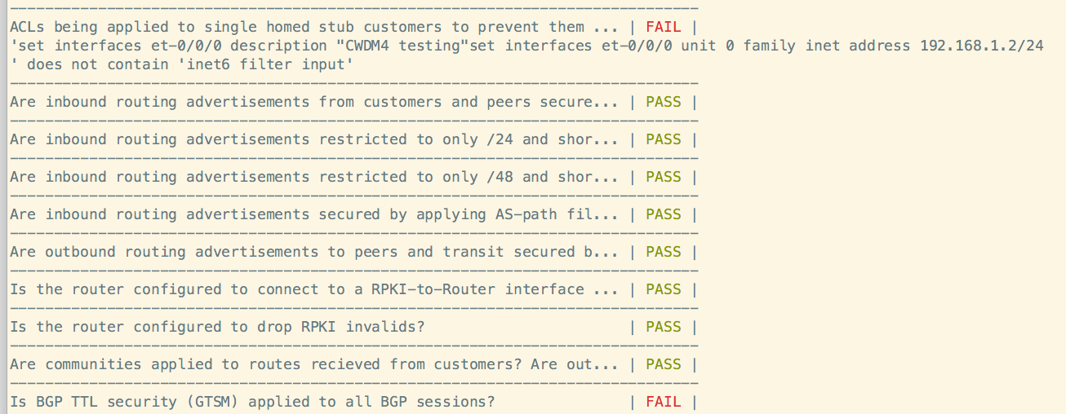
Sample output
Screenshot courtesy Rich Compton and Pratik Lotia

Slide 10
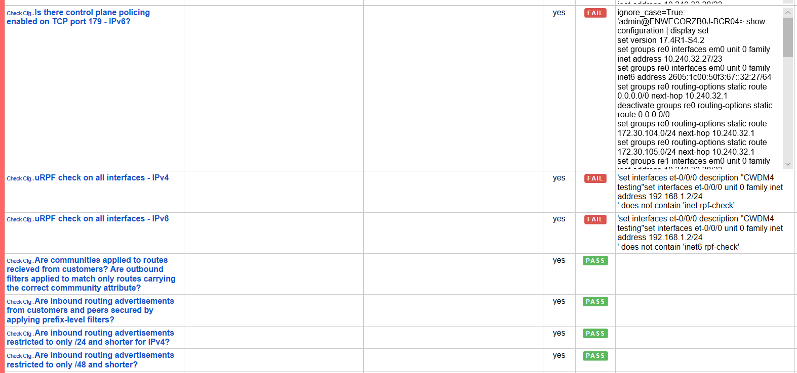
Reports
Screenshot courtesy Rich Compton and Pratik Lotia

Slide 11
From a prototype to a tool
Beta-test the prototype.
Verify that the results that the tool is outputting are results that people can actually use and will help them
Verify that people would actually use this tool. If not, then it's not worth putting in time to work on it. I'm not sure how we can verify this. Maybe a survey?
Increase the platforms supported by the tool.
Populate a “library” of configurations: what is the priority – MikroTik, Cisco IOS, Huawei?
Share the tool with others to encourage them to use it.

Slide 12
Could this be useful?
Would like to contribute?
manrs@isoc.org

