Slide 1
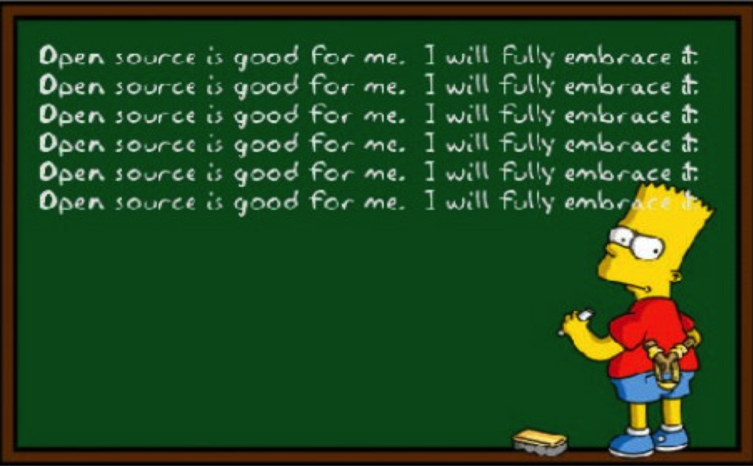
Open Source Working Group
RIPE 79, Wed October 16, 2019 14:00-15:30
Martin Winter & Ondrej Filip

Slide 2
Agenda
Administrative Matters [WG Chairs]
  Welcome
  finalize agenda
  approval of minutes from previous WG meeting(s)
  Results WG Chair Re-Election
Collaborative Open Source: MANRS Validator
(Leslie Daigle, ThinkingCat Enterprises)

Slide 3
Agenda
The Recent Development of the RPKI Validator Project
(Mikhail Puzanov, RIPE NCC)
NGI0: The Next Generation Internet Initiative
(Michiel Leenaars, Director of Strategy at NLnet Foundation)
Automating Networks Using Salt, Without Running Proxy Minions
(Mircea Ulinic, DigitalOcean)

