Slide 1
Internet clouds are (also) unpredictable!
A study of flow rerouting and latency variations across the largest Cloud network worldwide
Marco Chiesa KTH Royal Institute of Technology
Joint work with: Waleed Reda, Kirill Bogdanov, Alexandros Milolidakis, Gerald Q Maguire Jr, Dejan Kostic
Thanks to the RACI initiative!

Slide 2
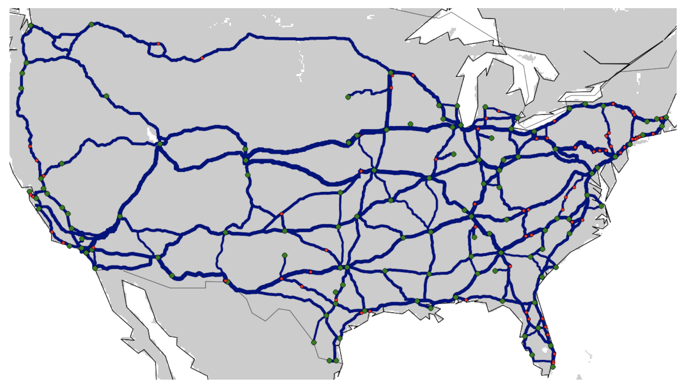
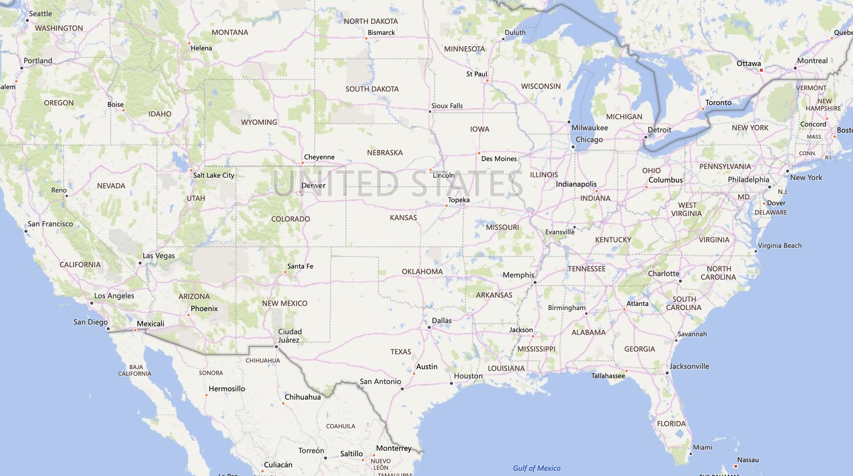
Let’s open a TCP connection between Oregon and Virginia

Slide 3
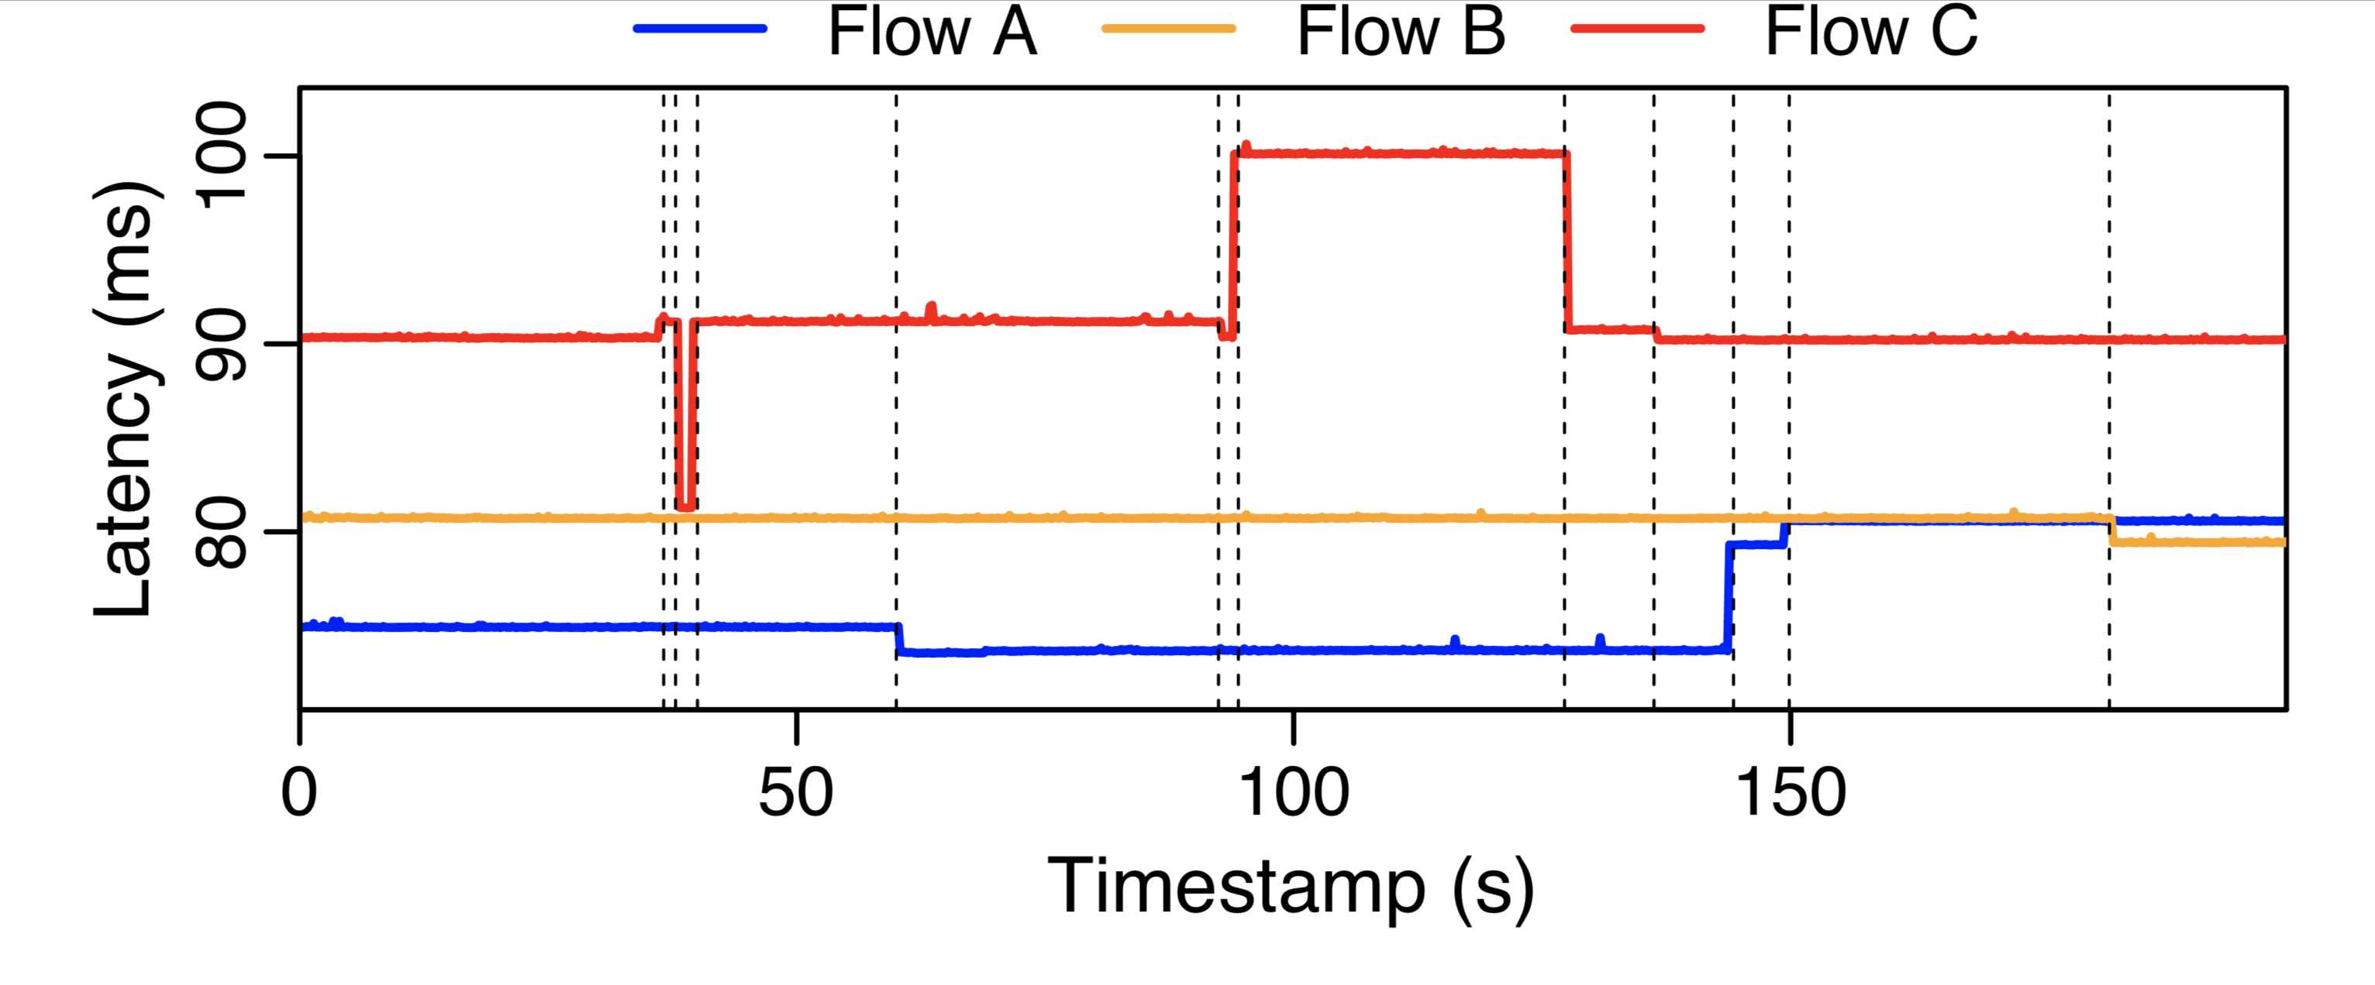
Stable Round Trip Time latency of roughly 80ms
Source port:
5327

Slide 4
We open a second connection: Up to 10% better latency!
Source port:
5327
8467
~10%

Slide 5
We open a third connection: Unstable and worse latency!
Source port:
5327
8467
9375

Slide 6
Insight #1: Flows experiences path changes at a second-level time scales
Source port:
5327
8467
9375
31s
stable
6s

Slide 7
Insight #2: Flows experience unfair performance
Source port:
5327
8467
9375
33%

Slide 8
Why do we see so many different latency behaviours?

Slide 9
Traffic Engineering (TE) : balance flows of traffic in a network
Periodic TE re-optimization in cloud networks:
2011: MPLS autobandwidth in Microsoft WAN*
today: (claimed) SDN-based TE at Amazon, Google, Microsoft
Two-phase TE:
compute (multiple) tunnels among region pairs
compute traffic splitting ratios among tunnels
typically hash-based implementation -> flow consistency
risk of reshuffling flow packets upon splitting ratio update!

Slide 10
Stateless hash-based traffic splitting: packets belonging to the same connection may be rerouted when traffic splitting ratios are modified
path A
$$1/6$$
TCP connection flow
$$1/3$$
path B
$$1/2$$
index | nexthop
0 | A
1 | B
2 | B
3 | C
4 | C
5 | C
path C
IP src, VIP
TCP src, dst
payload
Hash % 6

Slide 11
Stateless hash-based traffic splitting: packets belonging to the same connection may be rerouted when traffic splitting ratios are modified
path A
$$1/6$$
$$1/2$$
TCP connection flow
$$1/3$$
path B
$$1/2$$
index | nexthop
0 | A
1 | B
2 | B
3 | C → B
4 | C
5 | C
$$1/3$$
path C
IP src, VIP
TCP src, dst
payload
Hash % 6

Slide 12
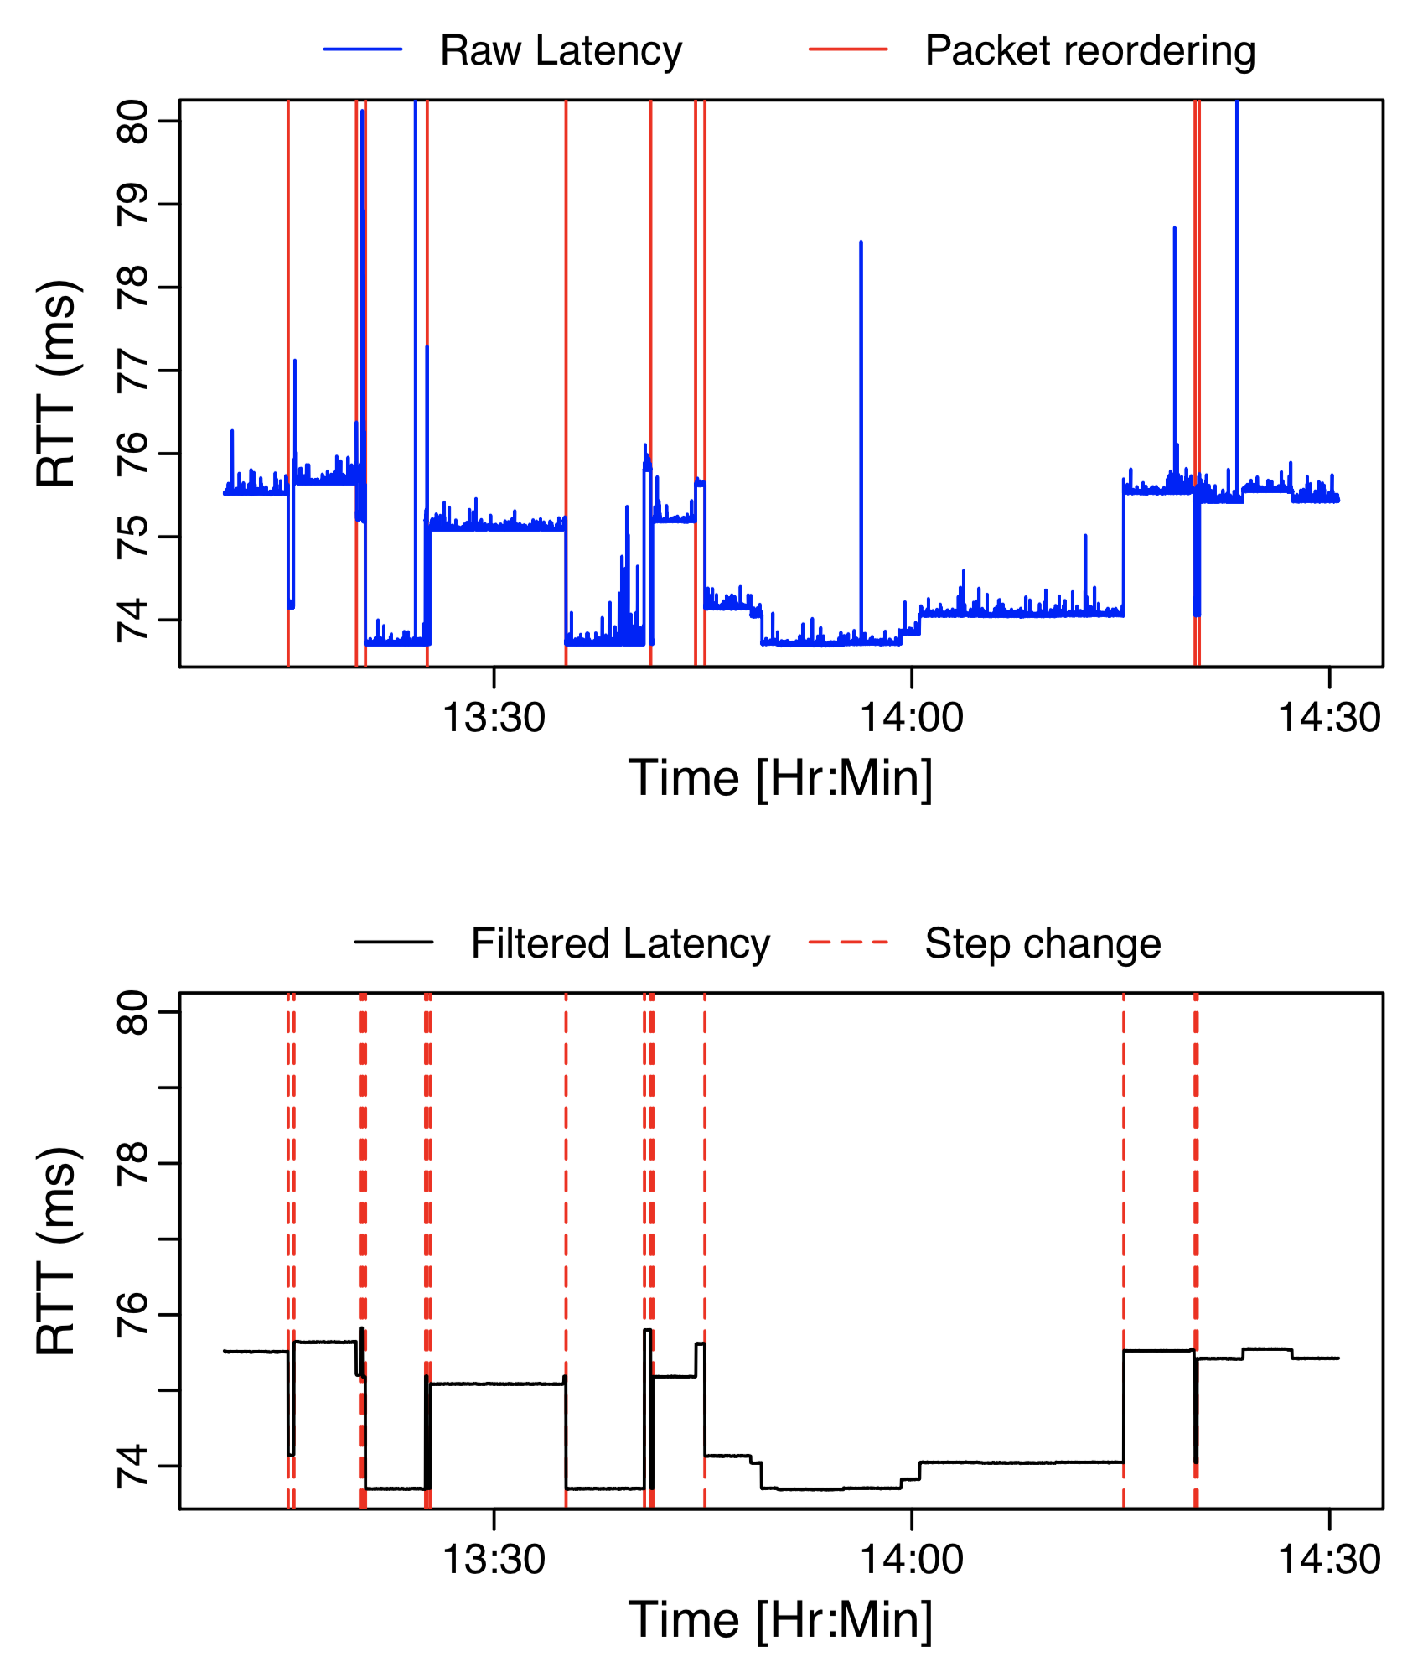
Let’s open a new connection and dissect it: latency = base propagation latency + congestion
Extract base propagation latency
filter congestion
we rely on variations of a rolling-minimum mechanism

Slide 13
The technical yet necessary part (bear with me): Extracting base propagation latency
Rolling-minimum sliding window:
stable if 3 out of 4 samples are within 0.5ms
update base propagation latency only if stable AND >0.5ms change
1 sec
8.00 7.95 7.90
Transient spike ≥ 0.5 ms
(unstable)
latency (ms)
Small variation < 0.5 ms
(stable)
time (s)
w_{n}
w_{n+1}
w_{n+2}
w_{n+3}
w_{n+4}
1-sec bin latency
7.9
8.2
8.3
8.2
9.8
6.8
7
7.1
Sliding window
(running minimum)
Base propagation
N/A
N/A
N/A
7.9
7.9
7.9
7.9
6.8
Ignore output from unstable windows w_{n+2} and w_{n+3}
Replace missing output with last valid propagation delay

Slide 14
The technical part: Extracting base propagation latency
The filtered base propagation latency
Extract base propagation latency
filter congestion
we rely on variations of a rolling-minimum mechanism
The interesting part: Are these really path changes?

Slide 15
Key intuition: a path change from a high to a low latency path causes packet reordering
4
3
2
1
4
3
2
1

Slide 16
The path change detector is accurate and conservative
We correlate packet reordering events with propagation latency:
zero false positives, i.e., a latency decrease >0.5ms is a path change
limited false negatives, i.e., path changes within 0.5ms -> conservative approach
henceforth, latency means base propagation latency
Filtered Latency
Step Change >0.5ms

Slide 17
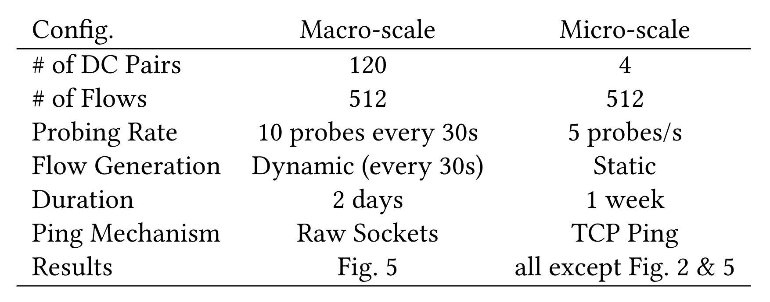
We can now detect path changes We set up an extensive measurement study of AWS
Picture credits: AWS re:Invent 2016: Tuesday Night Live with James Hamilton

Slide 18
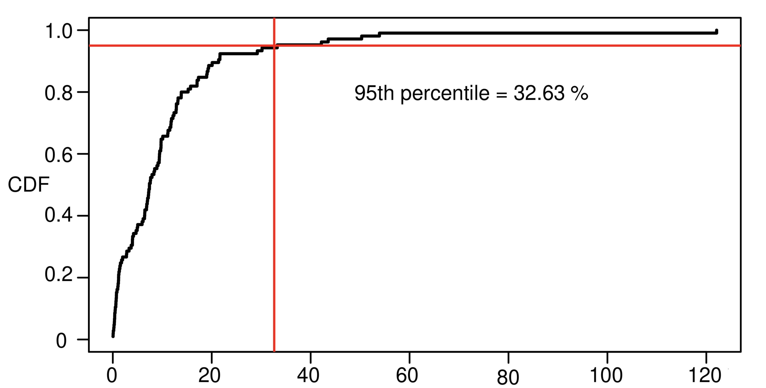
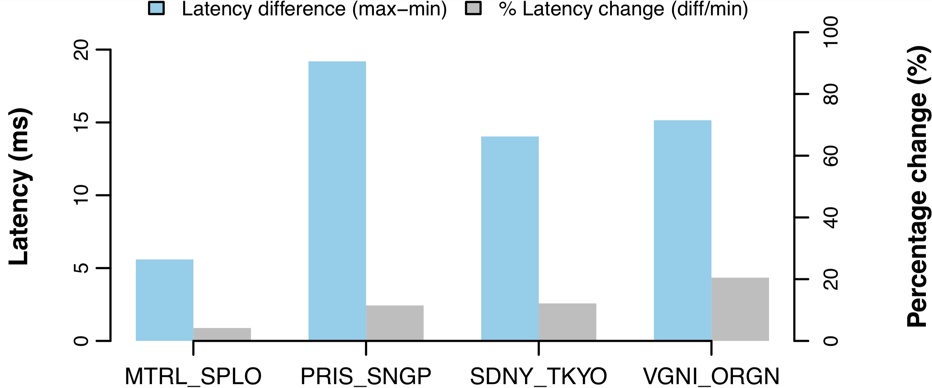
Some AWS regions have high latency variations across different flows (i.e., different source ports)
We looked at all the 120 region pairs in AWS:
Latency inflation: max-latency/min-latency
>32% latency inflation for 5% of region pairs
We zoomed into four AWS region pairs for the micro-scale experiments
neither the worst nor the best pairs
Fraction of region pairs
%
Sao Paulo,
Montreal
Singapore,
Paris
Sydney, Tokyo
Oregon,
Virginia

Slide 19
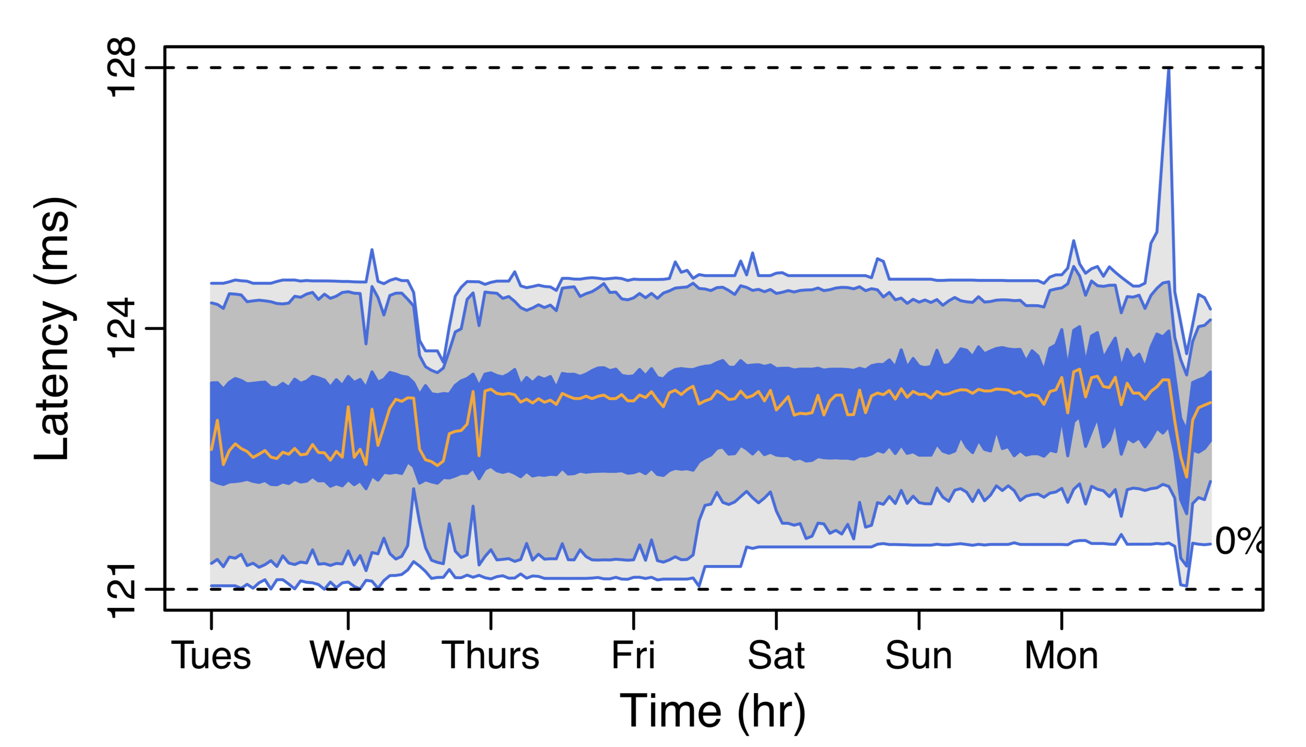
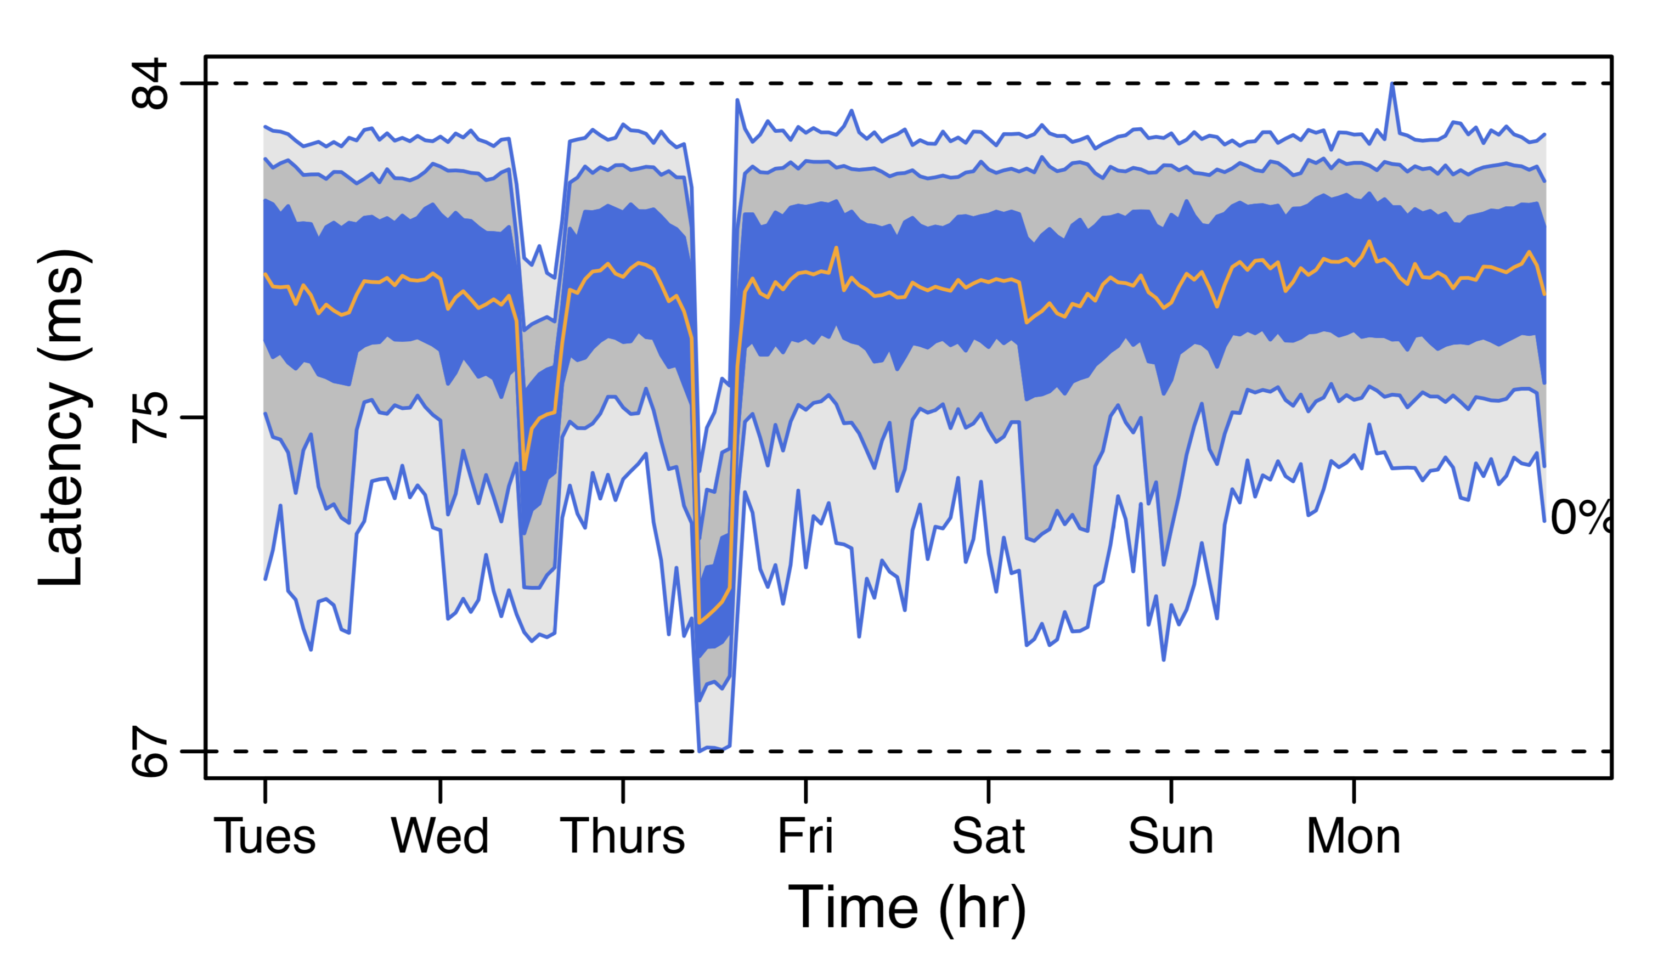
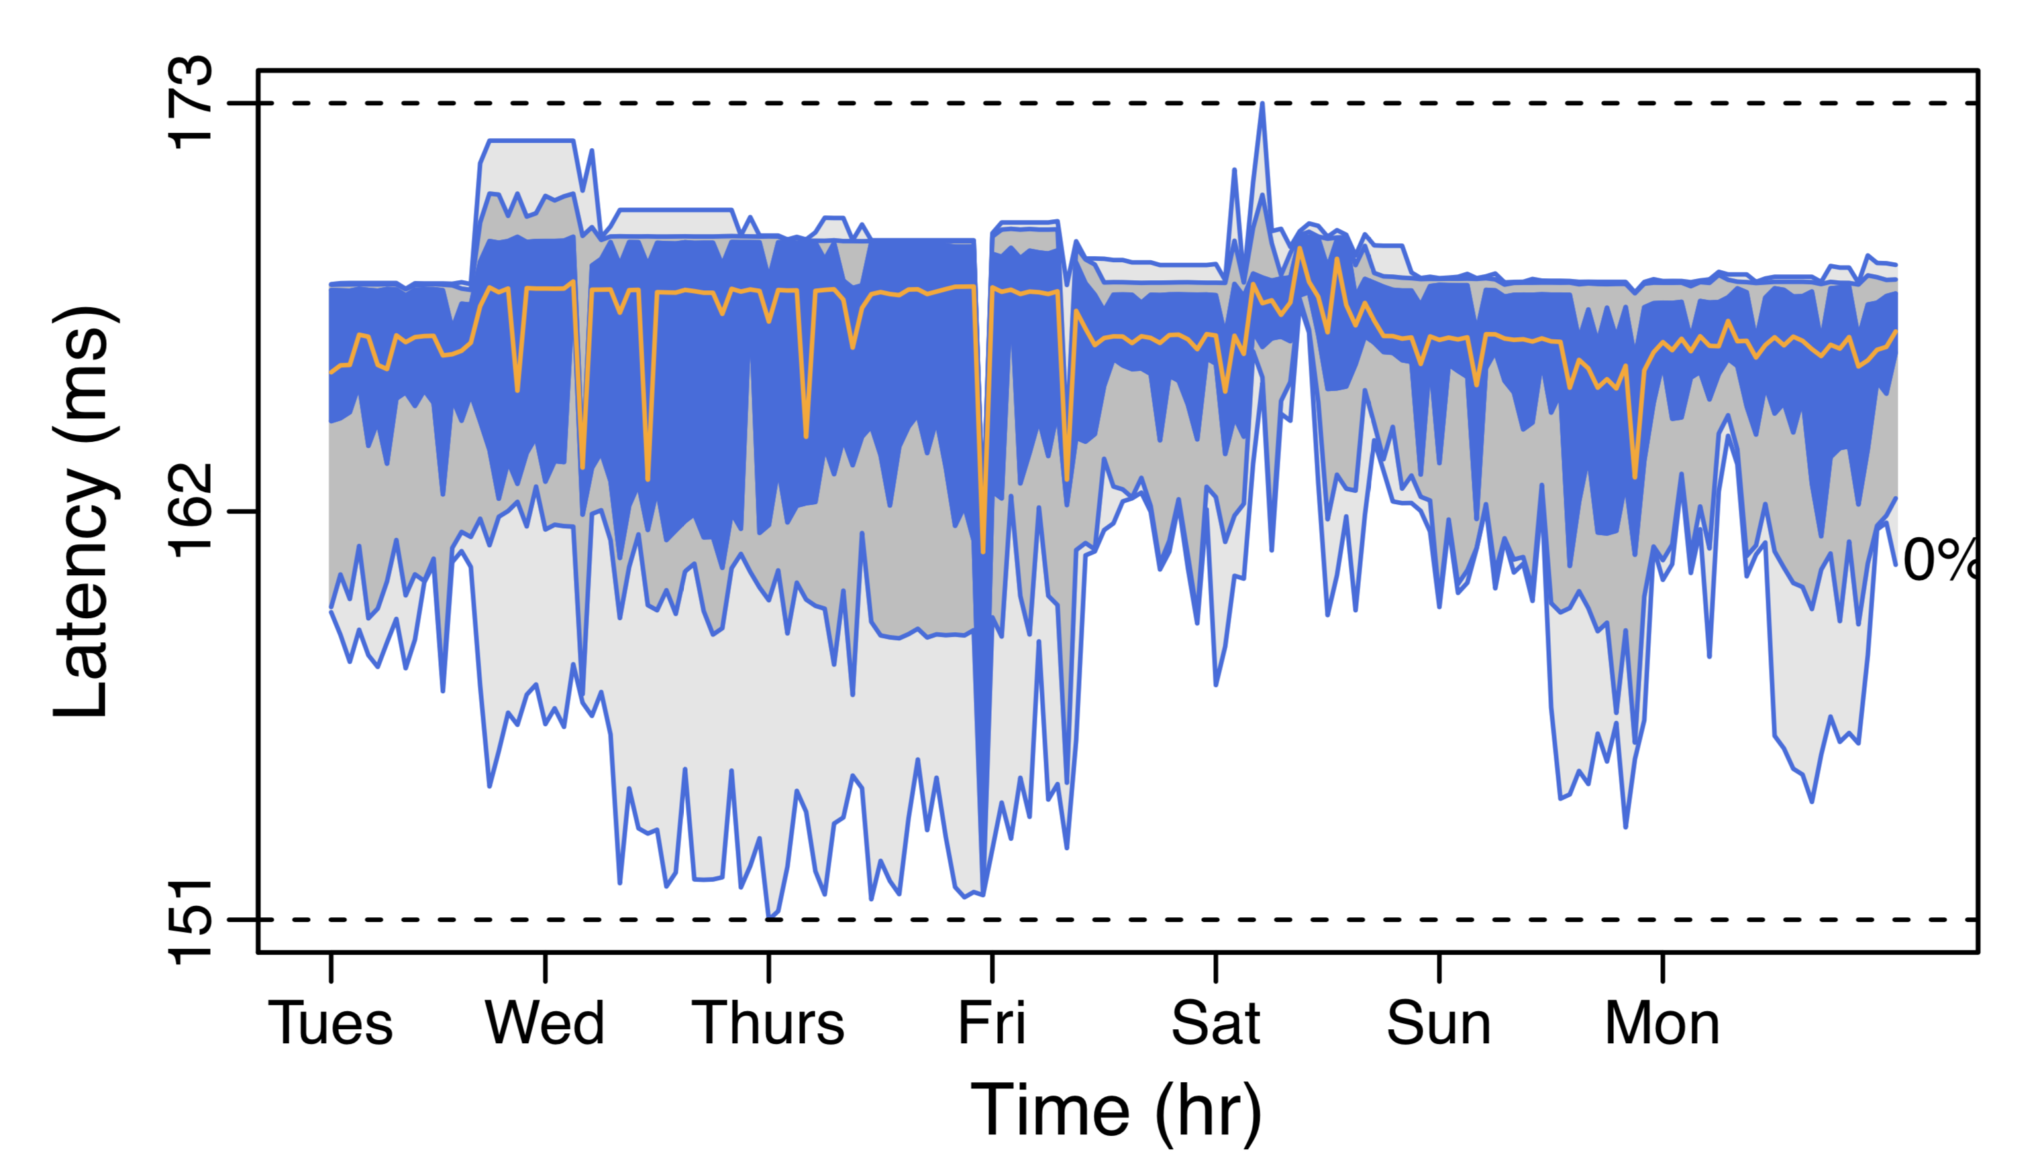
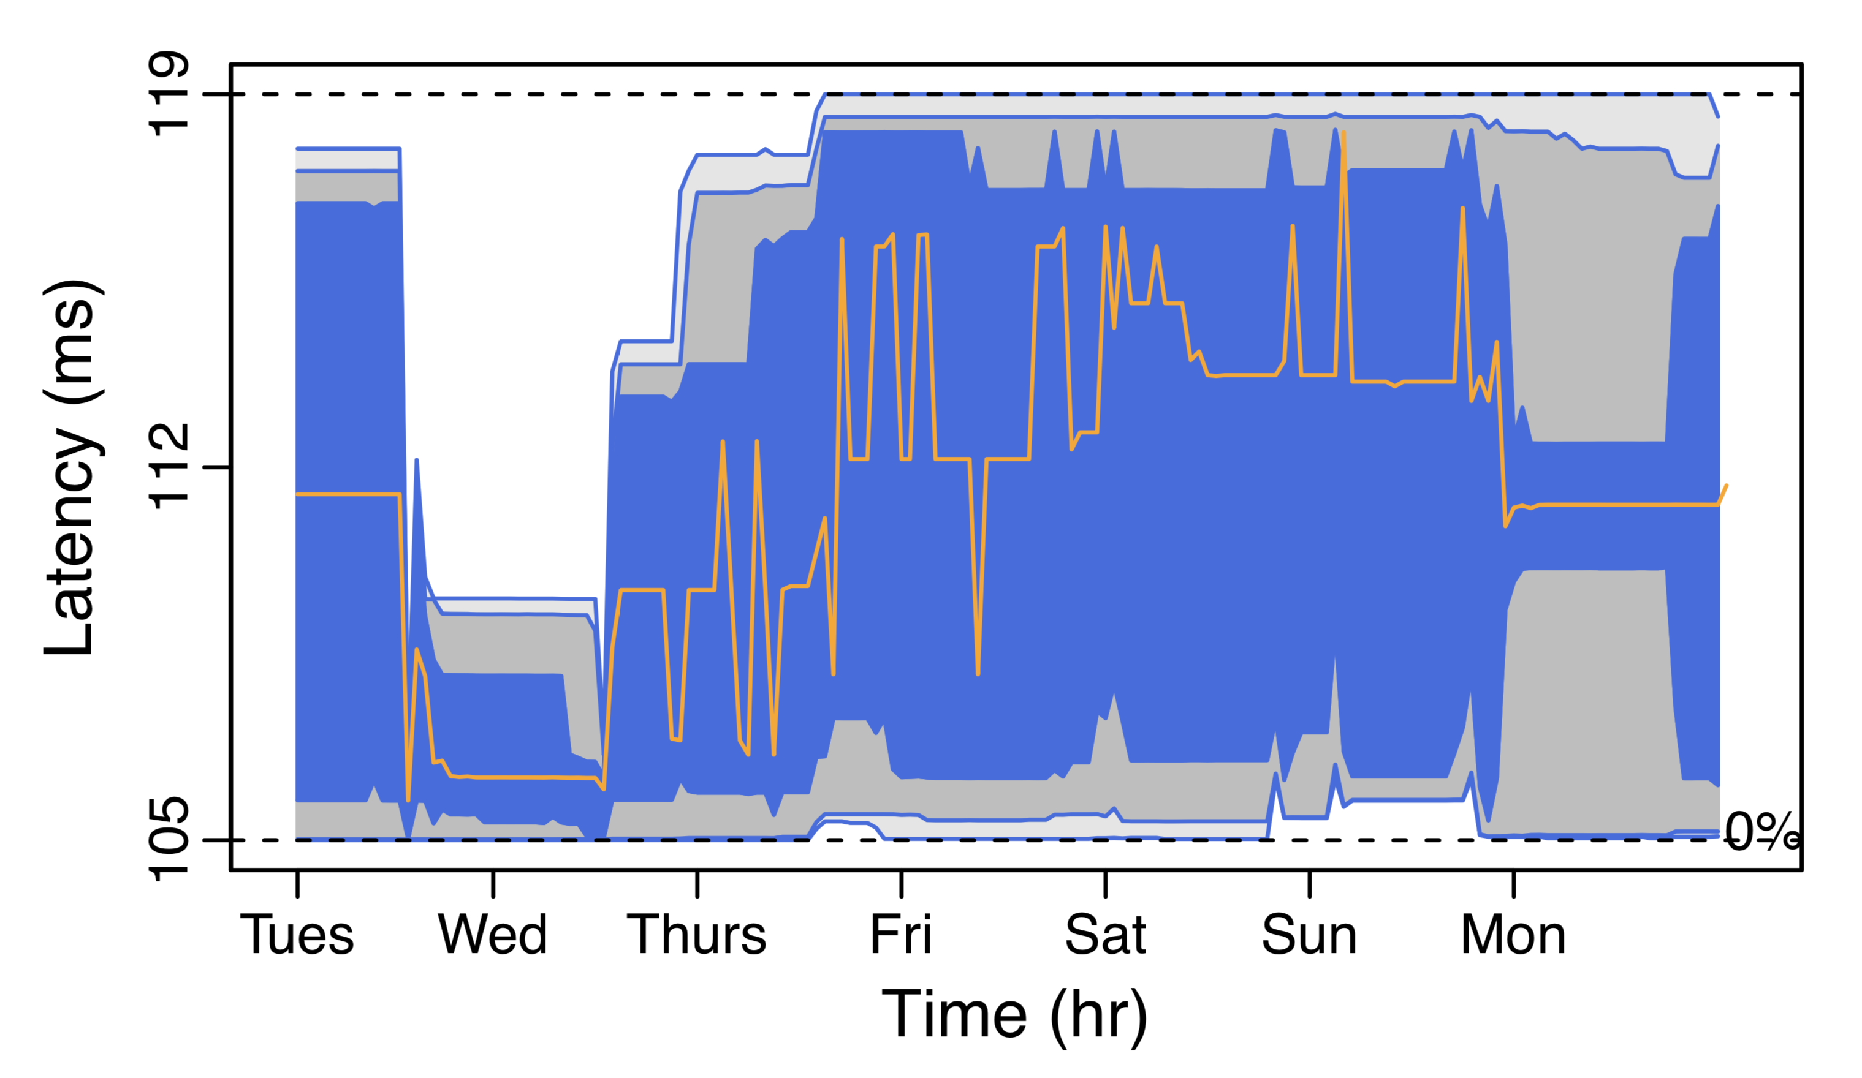
The flow-latency spectrum over time for four different pairs of regions
95’th perc
75’th perc
50’th perc
25’th perc
5’th perc
stable distribution but…
Sao Paulo - Montreal
paths (dis)appear!!!
Oregon - Virginia
The median case much worse than the best case
Singapore - Paris
Sydney - Tokyo

Slide 20
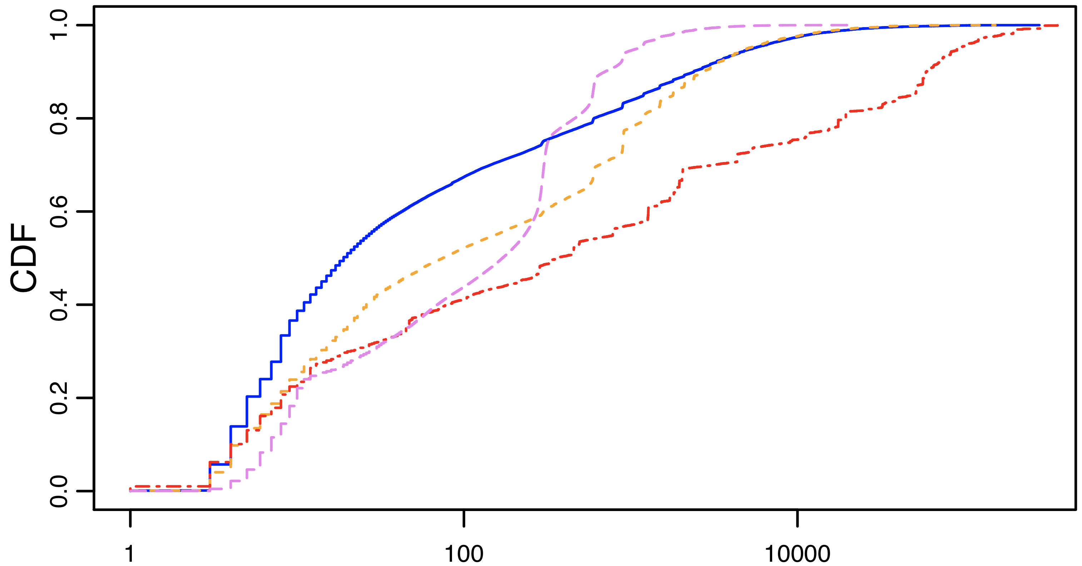
Stable distribution but… are the flows routed always on the same path? Not necessarily!
Consider all events when a flow changes path:
40% of the cases, the flow moves away within 10 seconds
Fraction of flow path change events
Flow persistence (s)

Slide 21
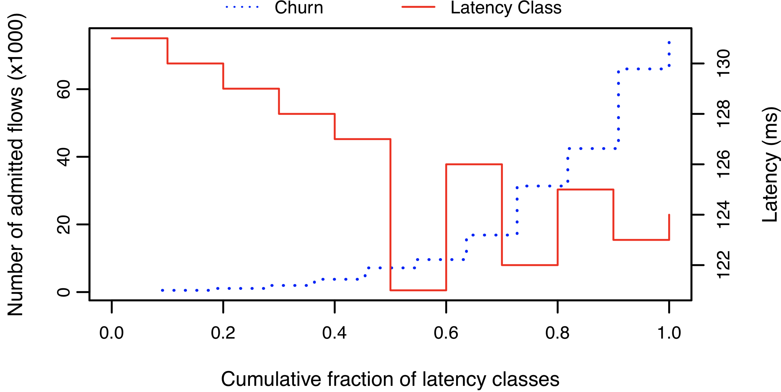
Flows routes on low-latency paths are more likely to experience a path change
We counted the number of flows moved away from a path per flow latency class (Oregon-Virginia):
number of moved flows is inversely proportional to flow latency
likely constrained shortest-path-based TE

Slide 22
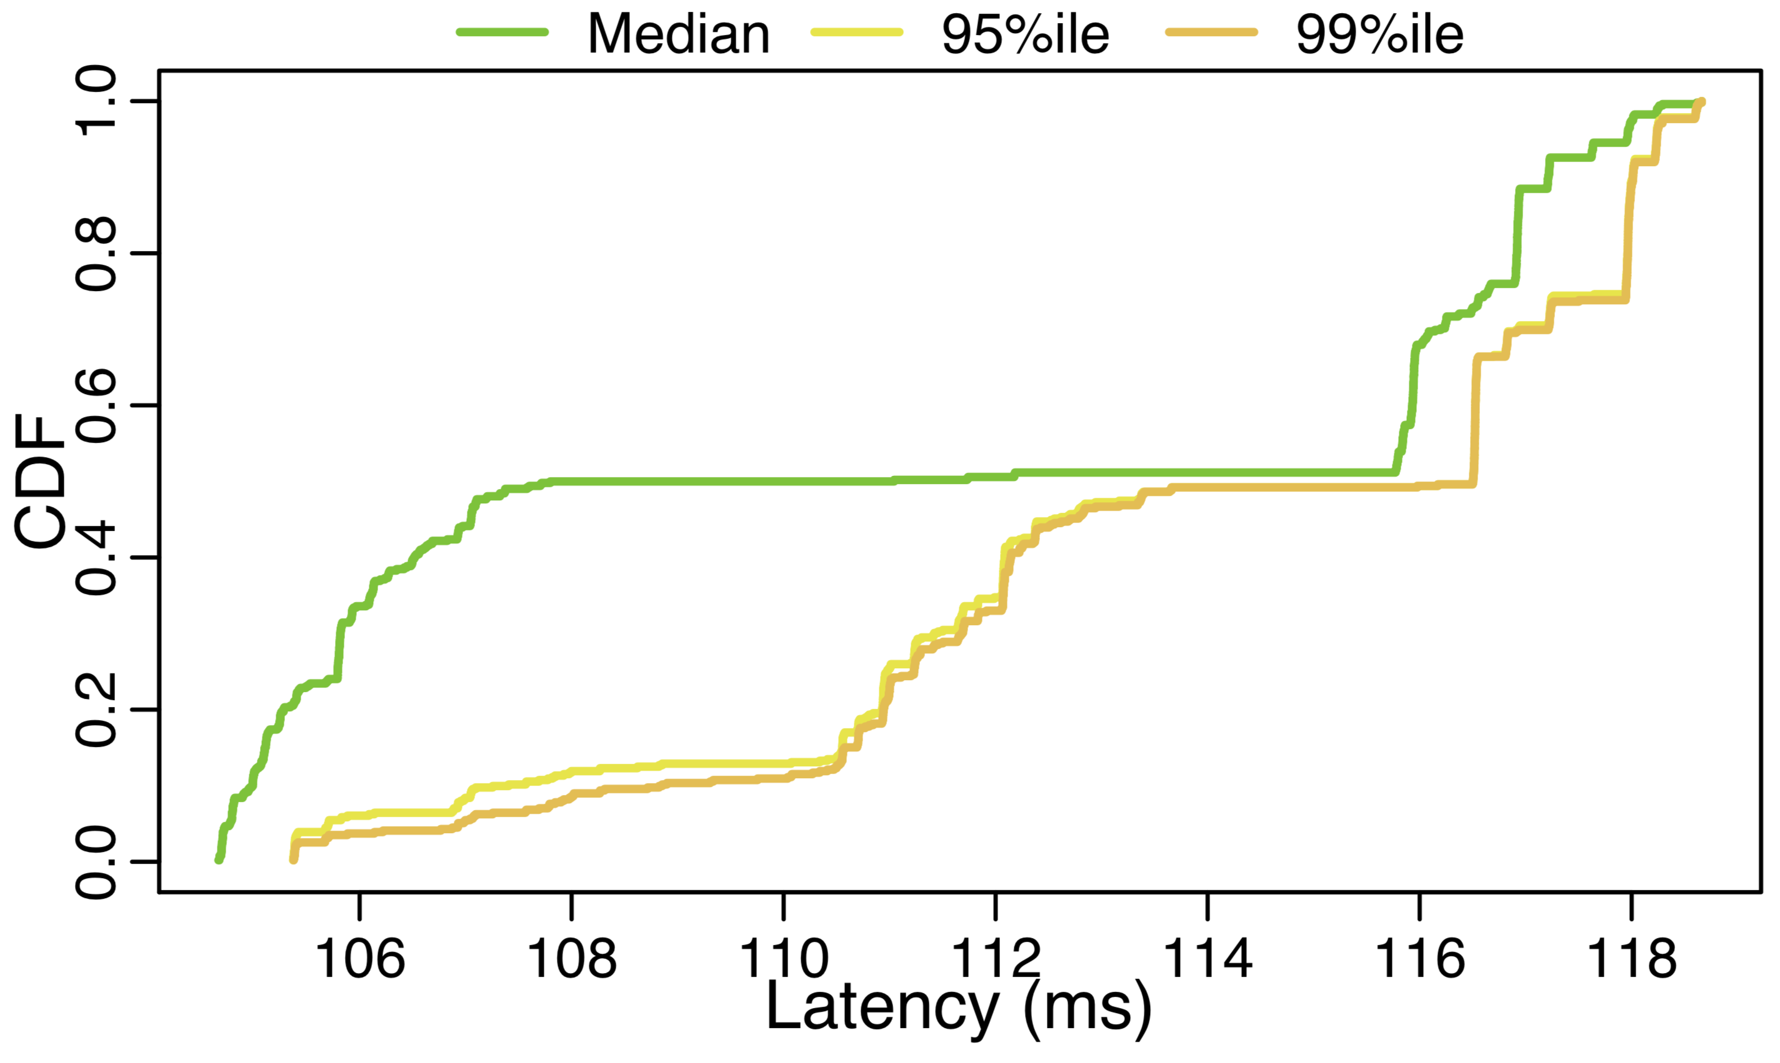
Measuring the level of ”unfairness” among flows
We measure the flow latency of each flow in 20-sec interval bins
we plot the 50’th, 95’th, 99’th latency percentiles
bimodal behaviour at 50’th
12% difference for all percentiles
Fraction of TCP connections
12%

Slide 23
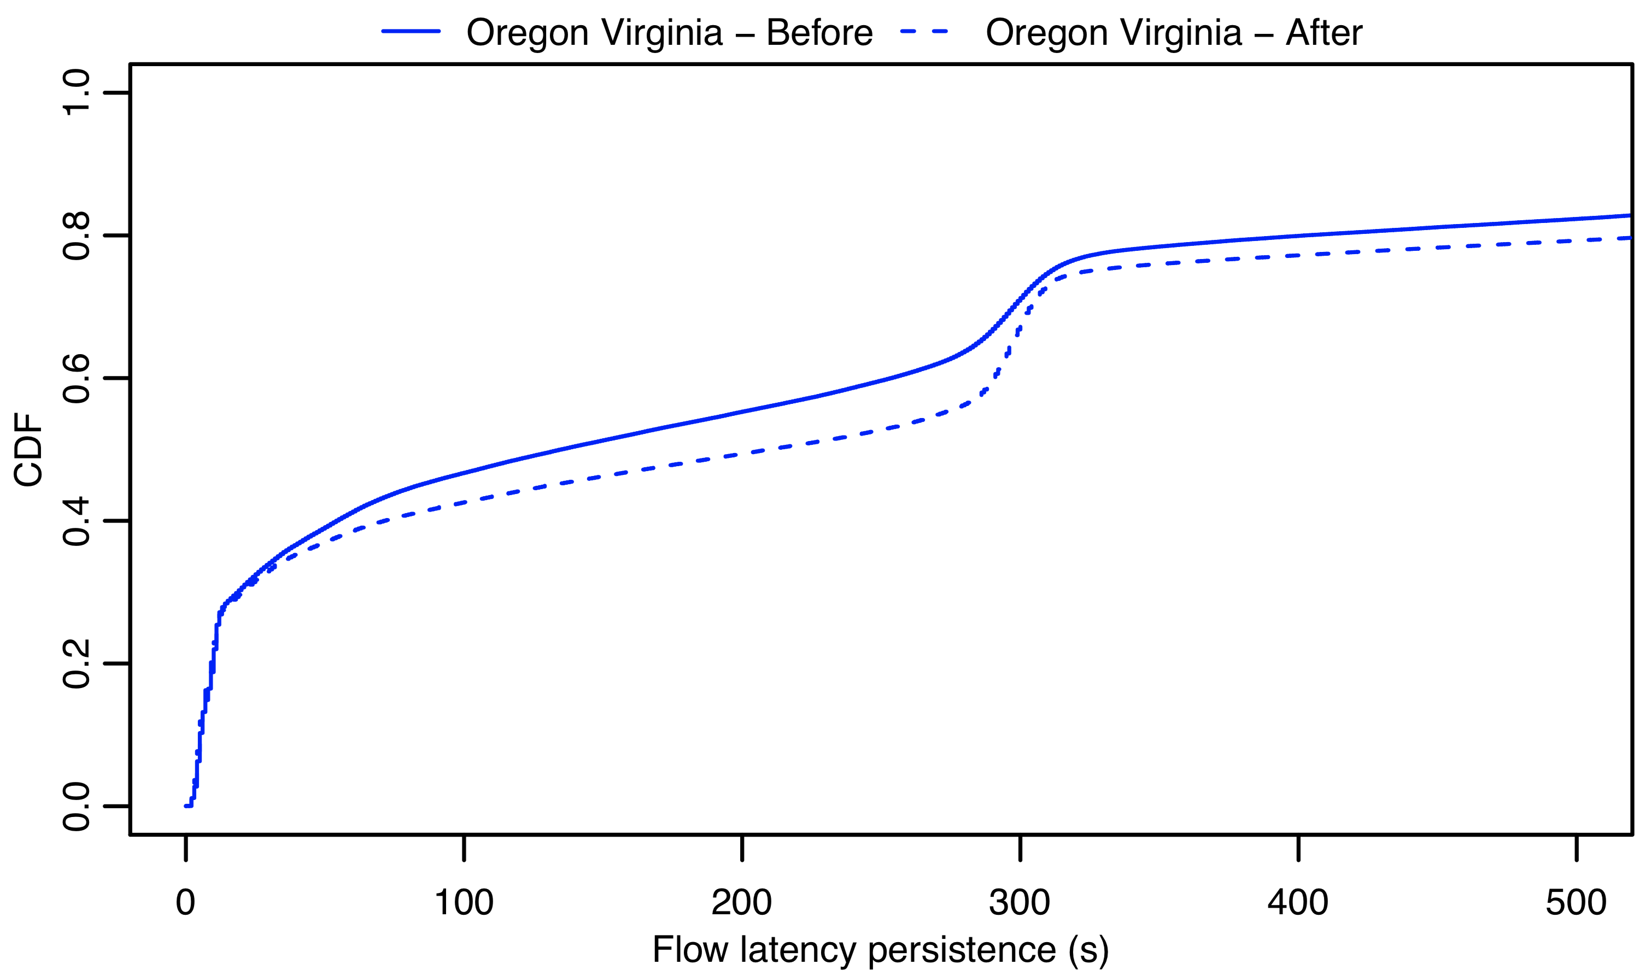
Measuring instabilities during ”low” or ”high” season
Large cloud networks tune the “aggressiveness” of their TE mechanisms according to the users’ load
We performed again the same measurements during “low” season, expecting to see less path changes
33%
Fraction of flow path change events
is this network update churn?

Slide 24
Moving 1K of data can take 18% more time when the flow is mapped to a high latency path
We generated a large number of iperf tests from Oregon (US west coast) to Virginia (US east coast)
We moved 1K of data in each iperf test
We did not observe any packet retransmission
Fraction of iperf connections
18%

Slide 25
Conclusions and takeaway
We measured the largest worldwide cloud backbone network (AWS):
Insight #1: very reactive TE, especially across some regions
Insight #2: flows experience unfair treatment
both in Round Trip Time and in the number of path changes
Far-reaching implications on the cloud ←→ tenants interaction:
congestion control: TCP Cubic suffers from packet reordering
latency: low-latency geo-distributed emerging applications require low and deterministic latencies
selfish-routing: application developers can force multiplexing of traffic on shortest paths, ultimately defeating cloud TE operation
Thank you! Marco Chiesa < mchiesa@kth.se > KTH Royal Institute of Technology

Slide 26
Selfish routing: giving control to the cloud tenants may lead to an unhealthy situation
$$2/3$$
10ms
user 1
user 2
A
B
user 3
$$1/3$$
100ms
10ms - low latency path
100ms - high latency path

Slide 27
Selfish routing: giving control to the cloud tenants may lead to an unhealthy situation
$$2/3$$
10ms
user 1
user 2
A
B
user 3
$$1/3$$
100ms
10ms - low latency path
100ms - high latency path

Slide 28
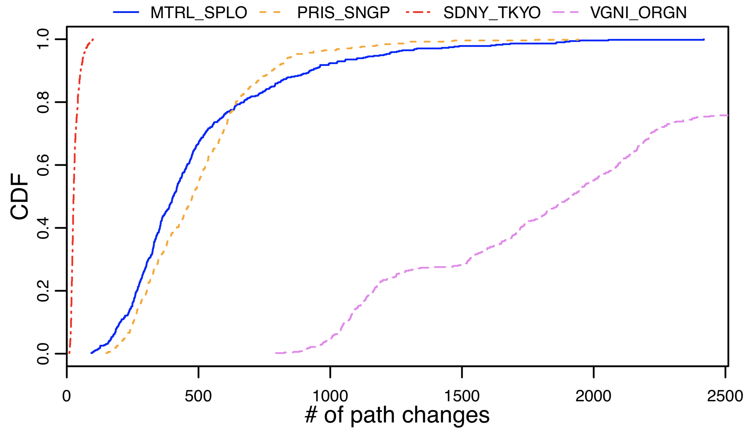
Traffic Engineering (TE) performed to (re)balance flows of traffic in a network
We measure the flow latency of each flow in 20-sec interval bins
we plot the 50’th, 95’th, 99’th latency percentiles
bimodal behaviour at 50’th
12% difference for all percentiles
Fraction of TCP connections

Slide 29
What’s the theory behind TE-based routing reconfigurations?
A rich body of literature on how to achieve optimal performance while minimizing traffic rerouting
Static routing is renown to be as far as

Slide 30
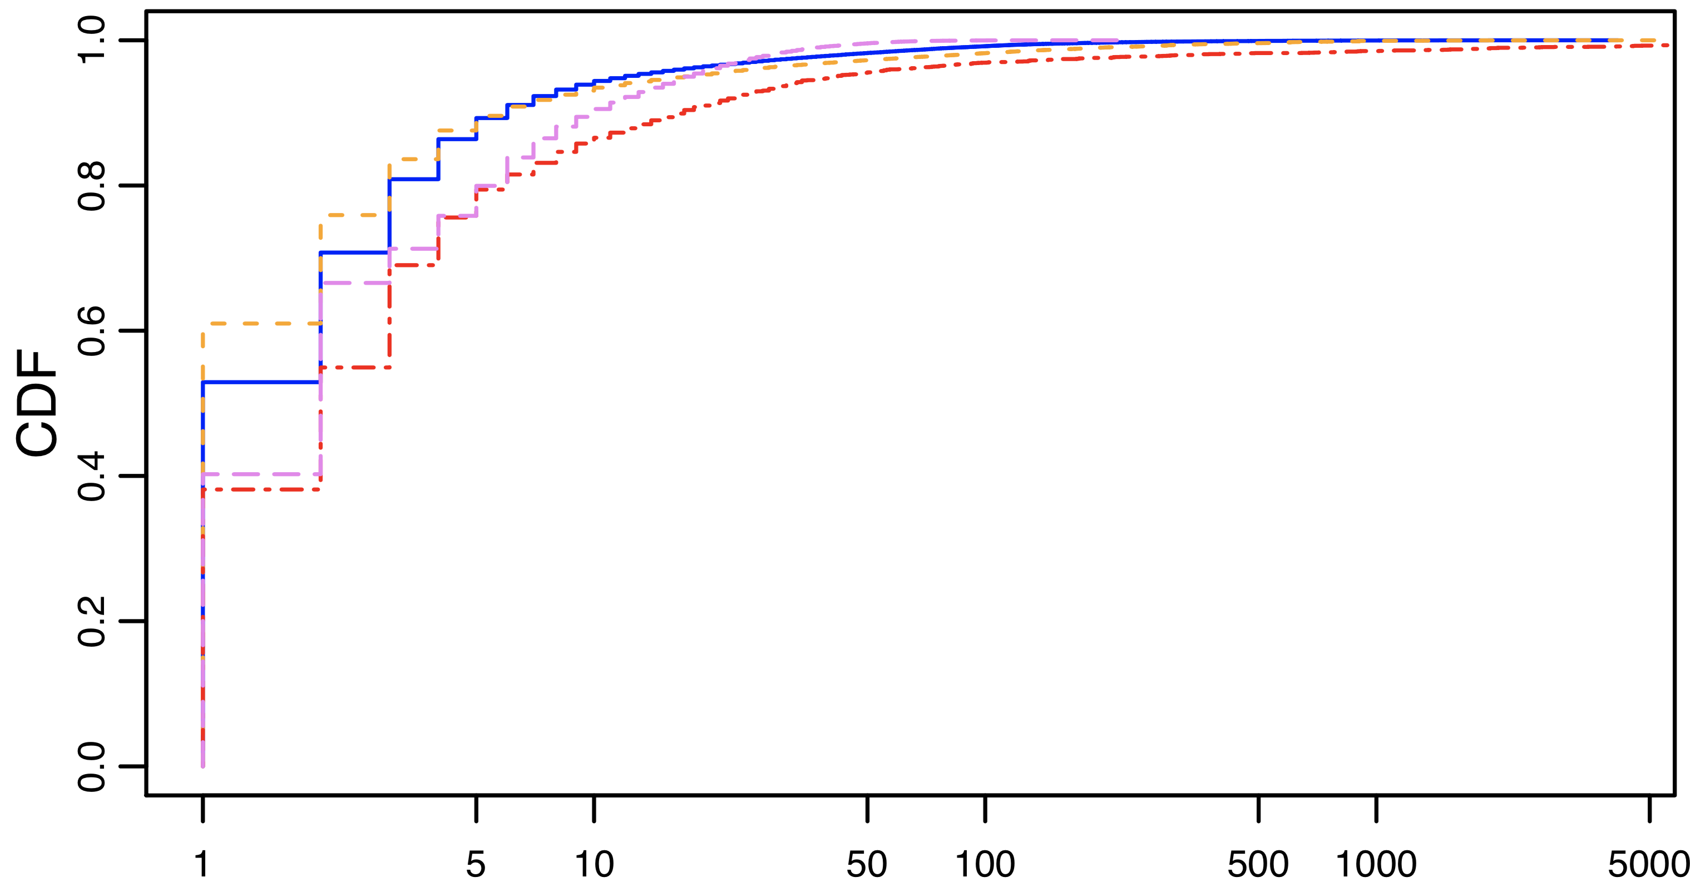
Flow path change interarrival time

Slide 31
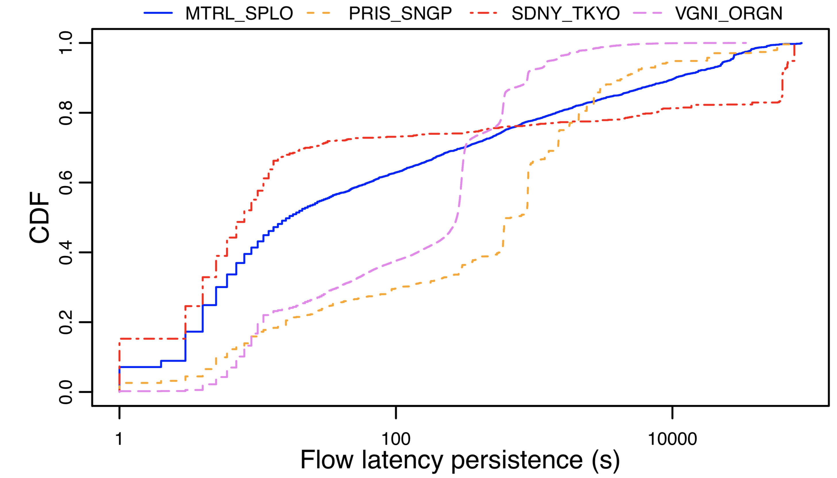
Flow persistence – forward path

Slide 32
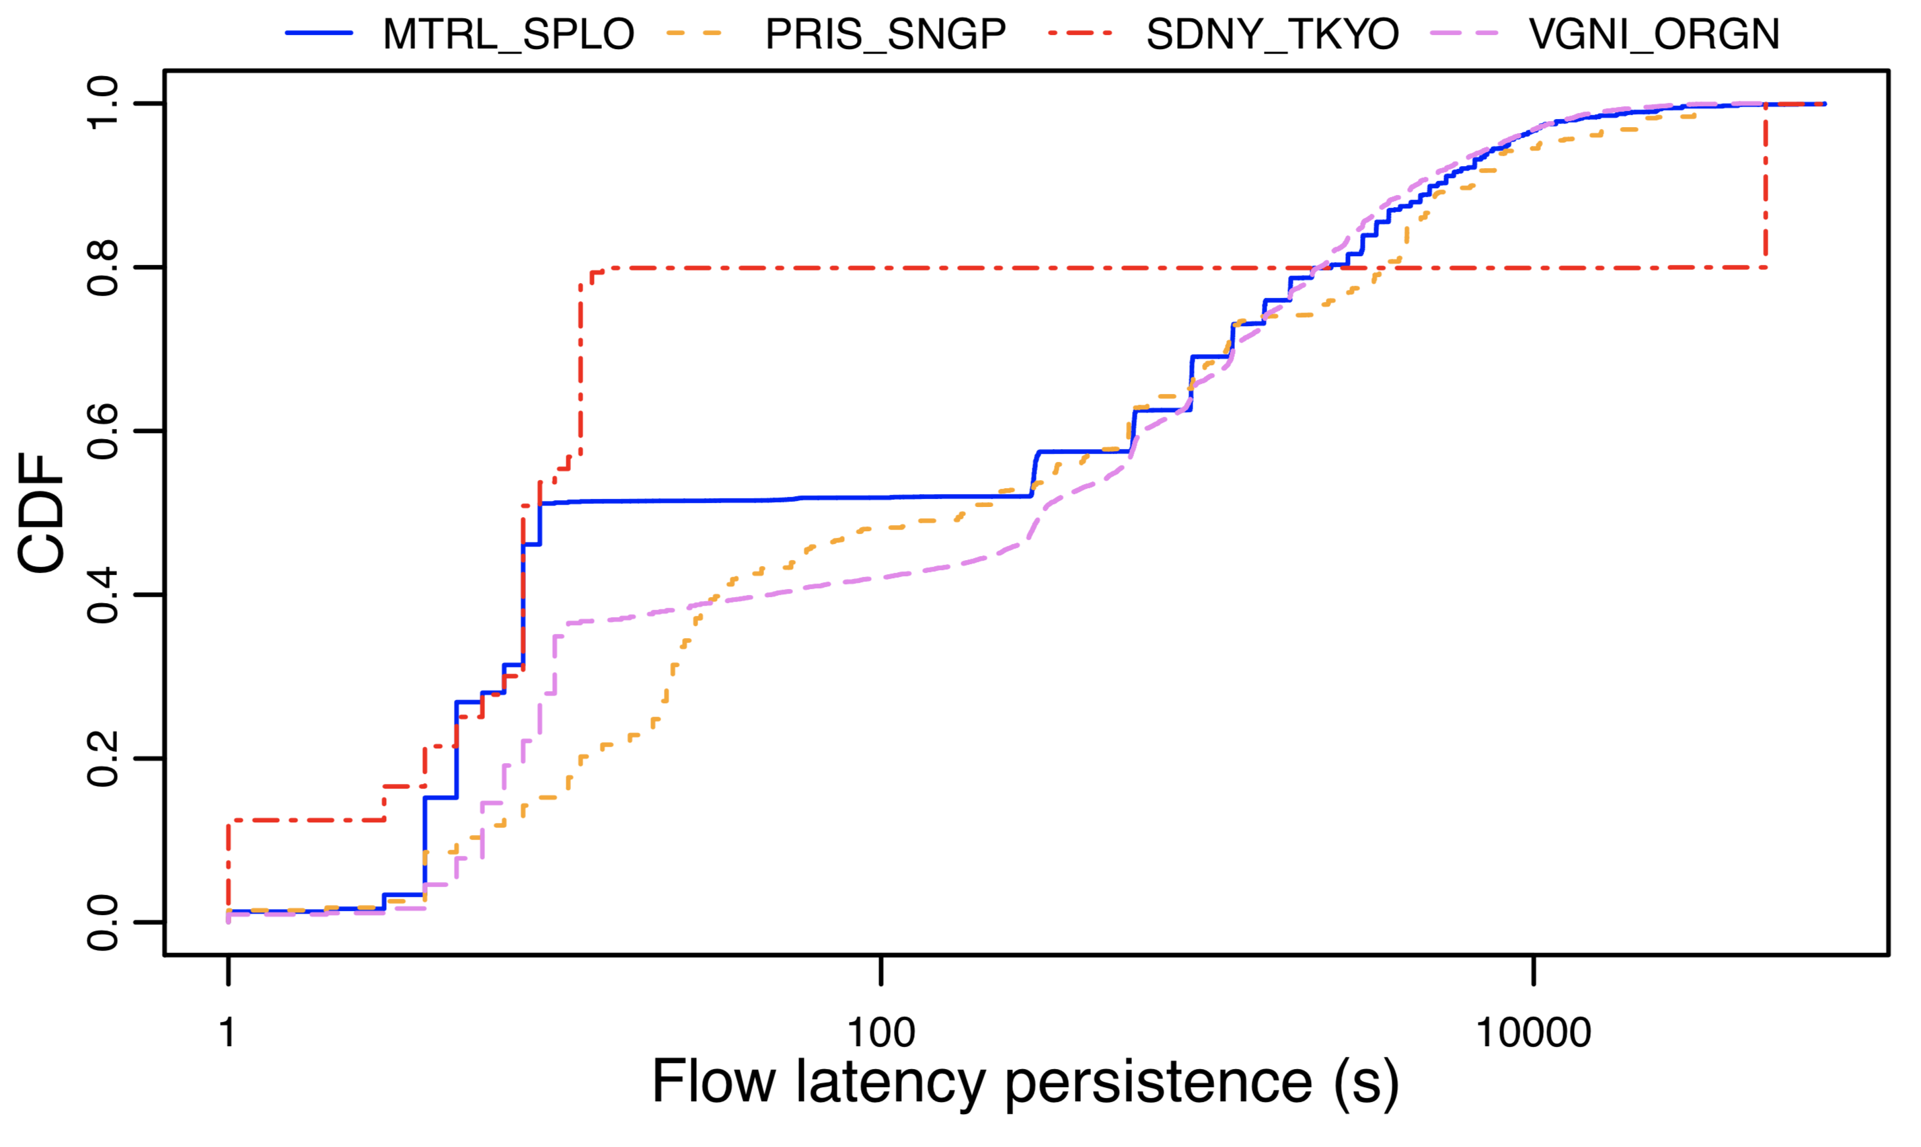
Flow persistence –reverse path

Slide 33
Traffic Engineering (TE) performed to (re)balance flows of traffic in a network

Slide 34
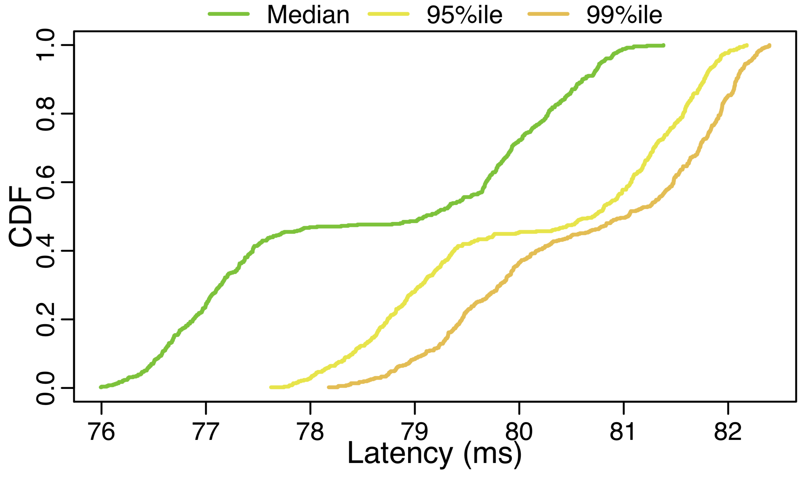
Traffic Engineering (TE) performed to (re)balance flows of traffic in a network

Slide 35
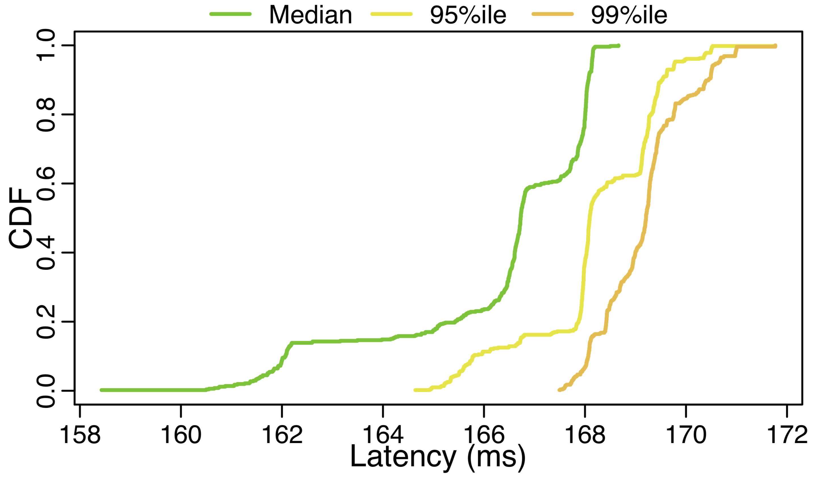
Traffic Engineering (TE) performed to (re)balance flows of traffic in a network

Slide 36
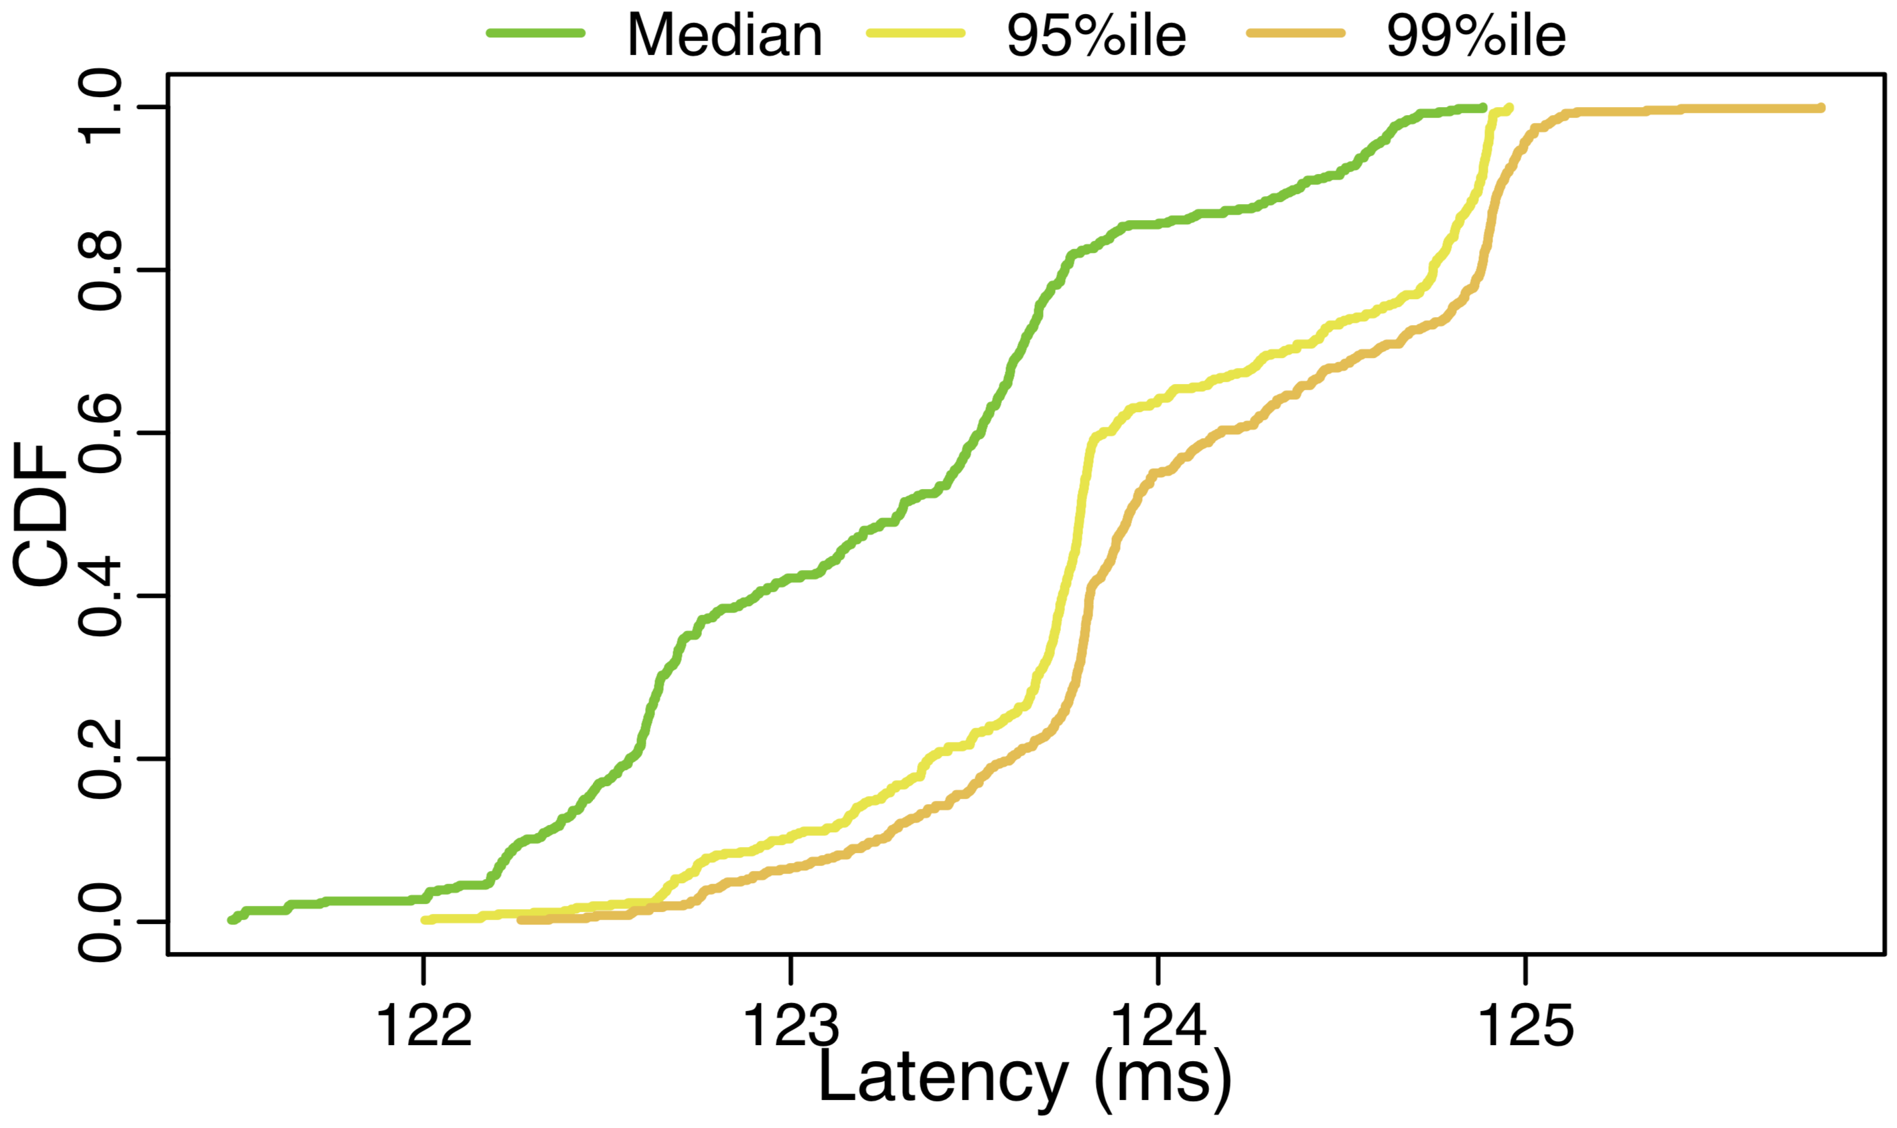
Traffic Engineering (TE) performed to (re)balance flows of traffic in a network

Slide 37
The “tragedy of the commons” in the cloud era
$$2/3$$
10ms
user 1
user 2
A
B
user 3
$$1/3$$
100ms
66%
33%
2 units
1 unit
2 units
1 unit
2 units
1 unit
10ms - low latency path
100ms - high latency path

Slide 38
The “tragedy of the commons” in the cloud era
$$2/3$$
10ms
user 1
user 2
A
B
user 3
$$1/3$$
100ms
78%
28%
2 units
2 units
1 unit
3 units
1 unit
10ms - low latency path
100ms - high latency path

Slide 39
The “tragedy of the commons” in the cloud era: a possibly unhealthy incentive to defeat cloud TE
$$2/3$$
10ms
user 1
user 2
A
B
user 3
$$1/3$$
100ms
88%
12%
2 units
3 units
3 units
1 unit
10ms - low latency path
100ms - high latency path

Slide 40
The “tragedy of the commons” in the cloud era: what if the cloud reacts by changing the ?
$$1/2$$
10ms
user 1
user 2
A
B
user 3
$$1/2$$
100ms
88%
12%
1.5 units
0.2 unit
2.8 units
0.2 unit
2.8 units
1.5 unit
10ms - low latency path
100ms - high latency path

Slide 41
The “tragedy of the commons” in the cloud era: what if the cloud reacts by changing the ?
$$1/2$$
10ms
user 1
user 2
A
B
user 3
$$1/2$$
100ms
88%
12%
1.5 units
3 units
3 units
1.5 unit
10ms - low latency path
100ms - high latency path

Slide 42
The “tragedy of the commons” in the cloud era: what if the cloud reacts by changing the ?
$$1/3$$
10ms
user 1
user 2
A
B
user 3
$$2/3$$
100ms
88%
12%
1 unit
0.2 unit
2.8 units
0.2 unit
2.8 units
2 units
10ms - low latency path
100ms - high latency path

Slide 43
The “tragedy of the commons” in the cloud era: what if the cloud reacts by changing the ?
$$1/6$$
10ms
user 1
user 2
A
B
user 3
$$5/6$$
100ms
70%
30%
0.5 unit
3 units
3 units
2.5 units
10ms - low latency path
100ms - high latency path

Slide 44
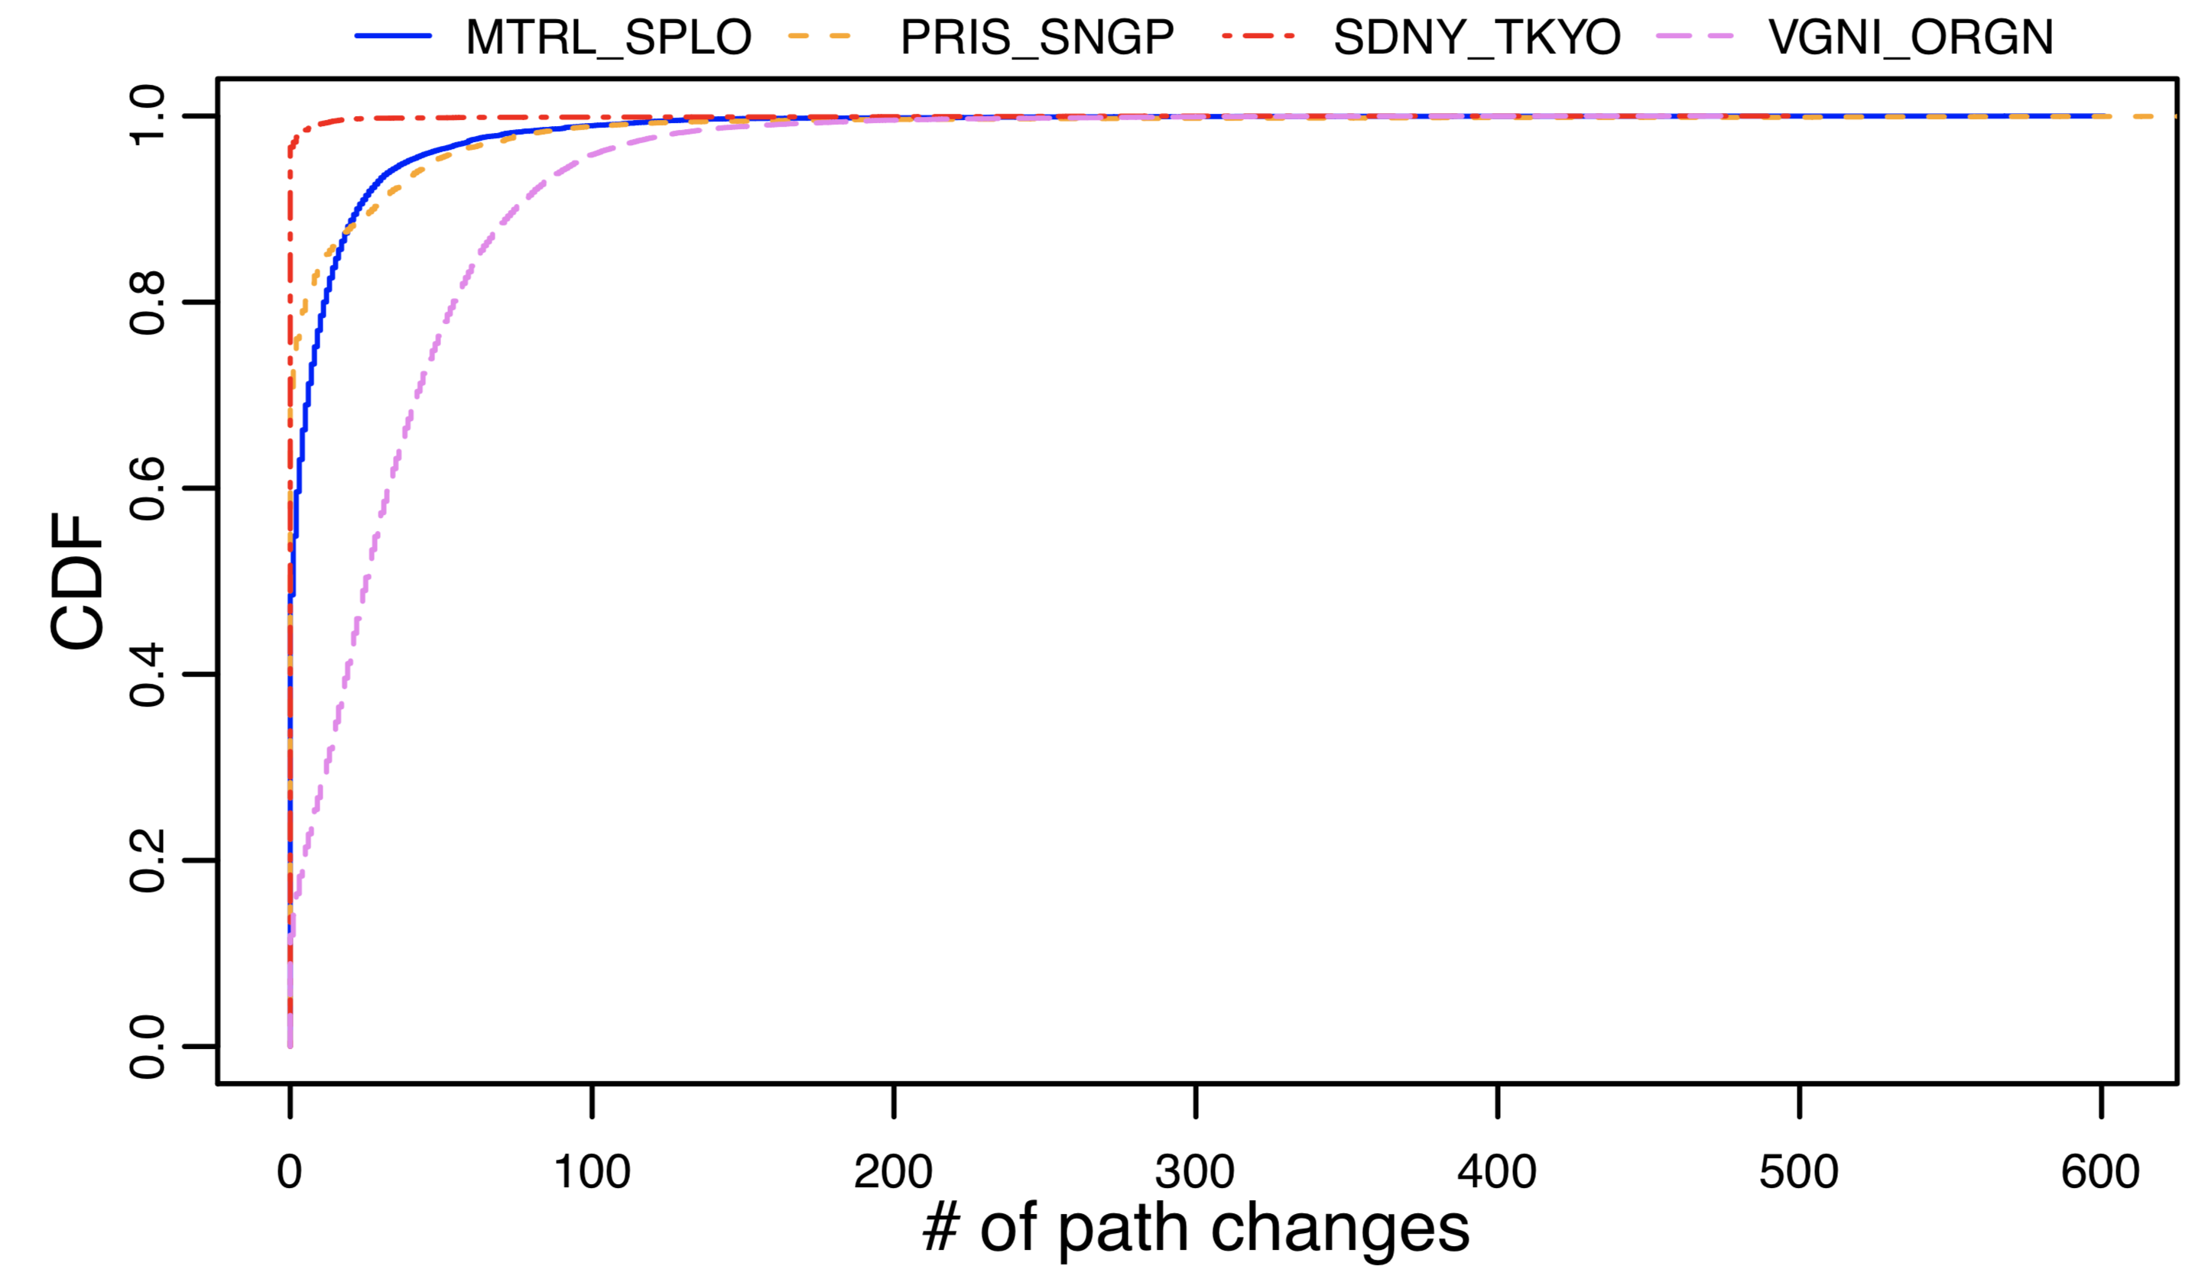
Stable distribution but… are the flows routed always on the same path? Not necessarily!
Consider all events when a flow changes path:
40% of the cases, the flow moves away within 10 seconds
We count #path-changes each 20 seconds
Sidney-Tokyo: during 1% of the time, we observe all the path changes
Virginia-Oregon: during 85% of the time, at least some flows change path
Fraction of flow path change events
Fraction of 20-sec time interval bins
Flow persistence (s)

Slide 45
This talk in a nutshell
We measured the largest worldwide cloud backbone network (AWS):
Insight #1: very reactive TE performed across datacenters
Insight #2: tenants’ flows experience unfair treatment
both in Round Trip Times and number of path changes
Far-reaching implications on how clouds and tenants interact:
congestion control: TCP Cubic suffers from packet reordering
latency: low-latency geo-distributed emerging applications require low and deterministic latencies
selfish-routing: application developers can force multiplexing of traffic on low-latency paths, ultimately hindering cloud TE operation

