Slide 1
When Can We Start Dropping IPv4 on the DNS Root Servers?
Erik Bais Discussion presentation

Slide 2
Problem statement
IPng has been mentioned in RFC’s since 1993 ( RFC 1550 )
Most RIR’s are not providing IPv4 space freely anymore
Adoption of IPv6 is lacking .. Even almost 8 years after the World IPv6 day in 2011.

Slide 3
How can we get v6 as the standard ?
Despite all efforts, most ISP’s and corporations are implementing v4 as the default numbering …
Management has little to no incentive to move to v6 ...

Slide 4
This is not a v4 vs v6 bashing presentation
We all know about the v4 status .. And we all love v6 …
No discussion/questions about one vs the other ..
Or about lacking deployments or possible lacking vendor support ..
It can’t be done or I’m scared isn’t a viable argument … (anymore)

Slide 5
The goal of this talk …
The goal is to think/talk about a possible date … in the future ..
Beyond a budget / investment period .. ( in case of new equipment )
Let’s start the discussion with some statements …

Slide 6
DNS Rootserver Operators
All Operators support v4 AND v6 for root-server operations. (Finaly)
But not all nodes of those operators, support dual-stack (yet?) ..
Those nodes should be fixed or removed …

Slide 7
Root-servers by name & IP address
Source: https://www.iana.org/domains/root/servers

Slide 8
Example of a node overview - Nednod
Source: https://root-servers.org

Slide 9
ISP DNS resolvers
ISP’s can fix their own resolvers for dual-stack within a couple hrs.
It will allow all their internal customers to connect both with v4 and v6.
Even if the root-server they query, only resolves on v6
Required : a v6 prefix in BGP, fix their resolvers to support dual-stack.
Cost : Free of charge, time to implement is required. Resolver software can be free of charge.

Slide 10
Simplified example

Slide 11
Statement 1
All DNS Root servers are currently dual-stacked …
Most (!!) .tlds are dual-stacked. Some vanity tlds are not ?? (!!)
Some nodes are not v6 enabled ... IPv6 only isn’t flagged … while IPv4 only is.
IPv6 is free to obtain for all RIPE NCC members.
IPv6 is almost free for non-members of RIPE.
The goal is to get all ISP’s to have IPv6 implemented in BGP in 5 years.

Slide 12
IPv6 allocations and Announced .. and usage

Slide 13
Statement 2
As all ISP’s have IPv6 and in BGP (even if it would be in a free software router on a second hand server … even without doing any traffic .. )
The initial step is to get your DNS Servers dual-stacked.
All current DNS software supports IPv6 and dual-stack configs. Out of the box at no additional charge / cost.

Slide 14
Statement 3
If a dual-stack DNS resolver can reach the DNS Rootservers over IPv6 ….. And IPv6 is the preferred default for most, if not all OS’s …
Or is it ??
Then there is NO technical requirement for DNS Rootservers to keep supporting IPv4 …
Except for out-dated security tools in military environments and filtering regime’s ...
Spoiler: They have their own root servers (!!) so who cares ?? …

Slide 15
Statement 4
IPv6 MUST be the only supported protocol on nodes for DNS Rootserver operators within 7 years …
Reduction off active IPv4 enabled nodes using unicast in after 5 years..
This will make it somewhat ‘slower’ for IPv4 only enabled resolvers to use a DNS Root server. And give faster responses to IPv6 enabled nodes.
Marketing ramp-up ... IPv4 Only networks will go off-line in 2026

Slide 16
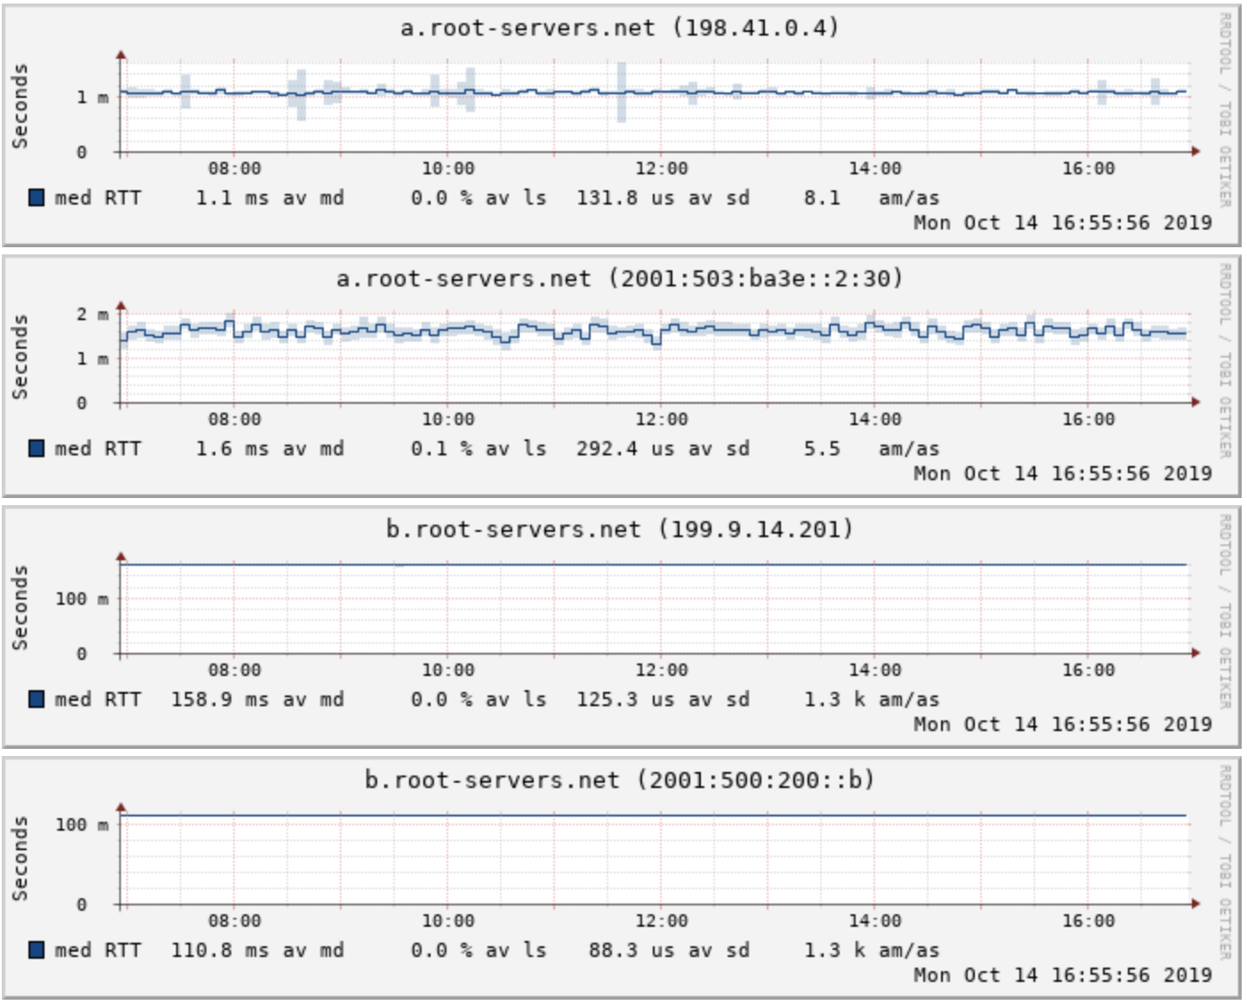
Stats from our network

Slide 17
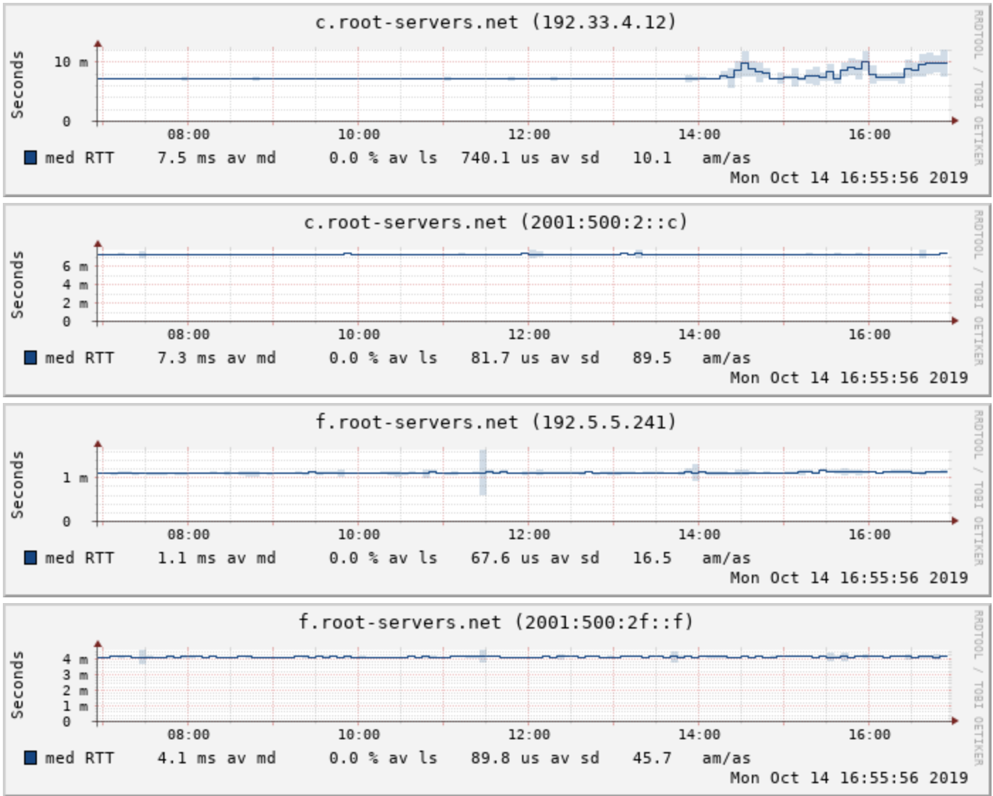
Stats from our network

Slide 18
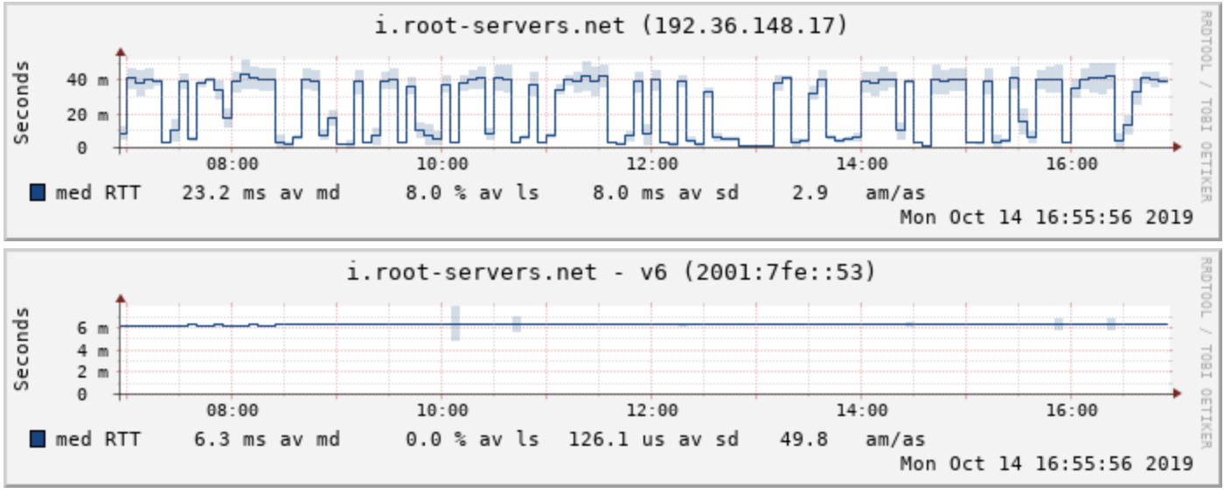
Stats from our network

Slide 19
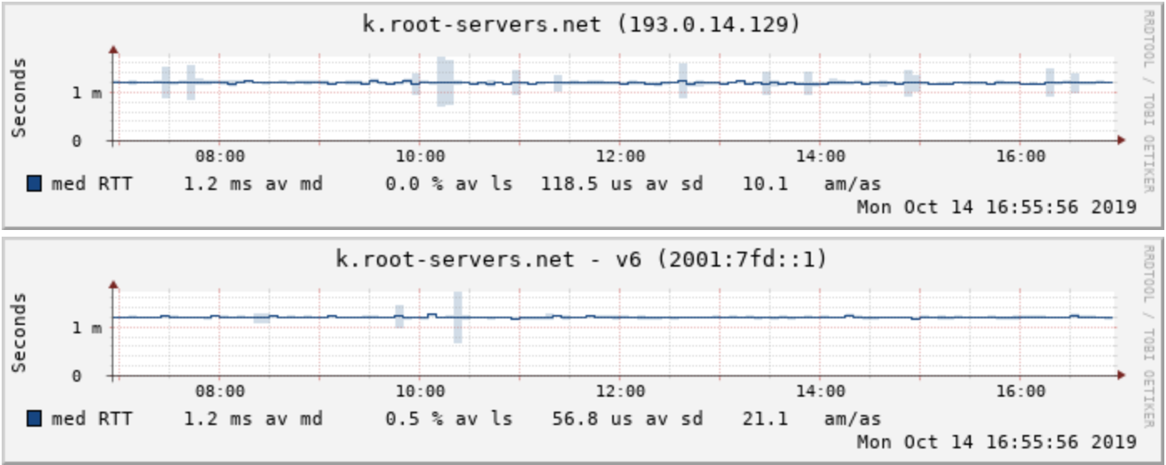
Stats from our network

Slide 20
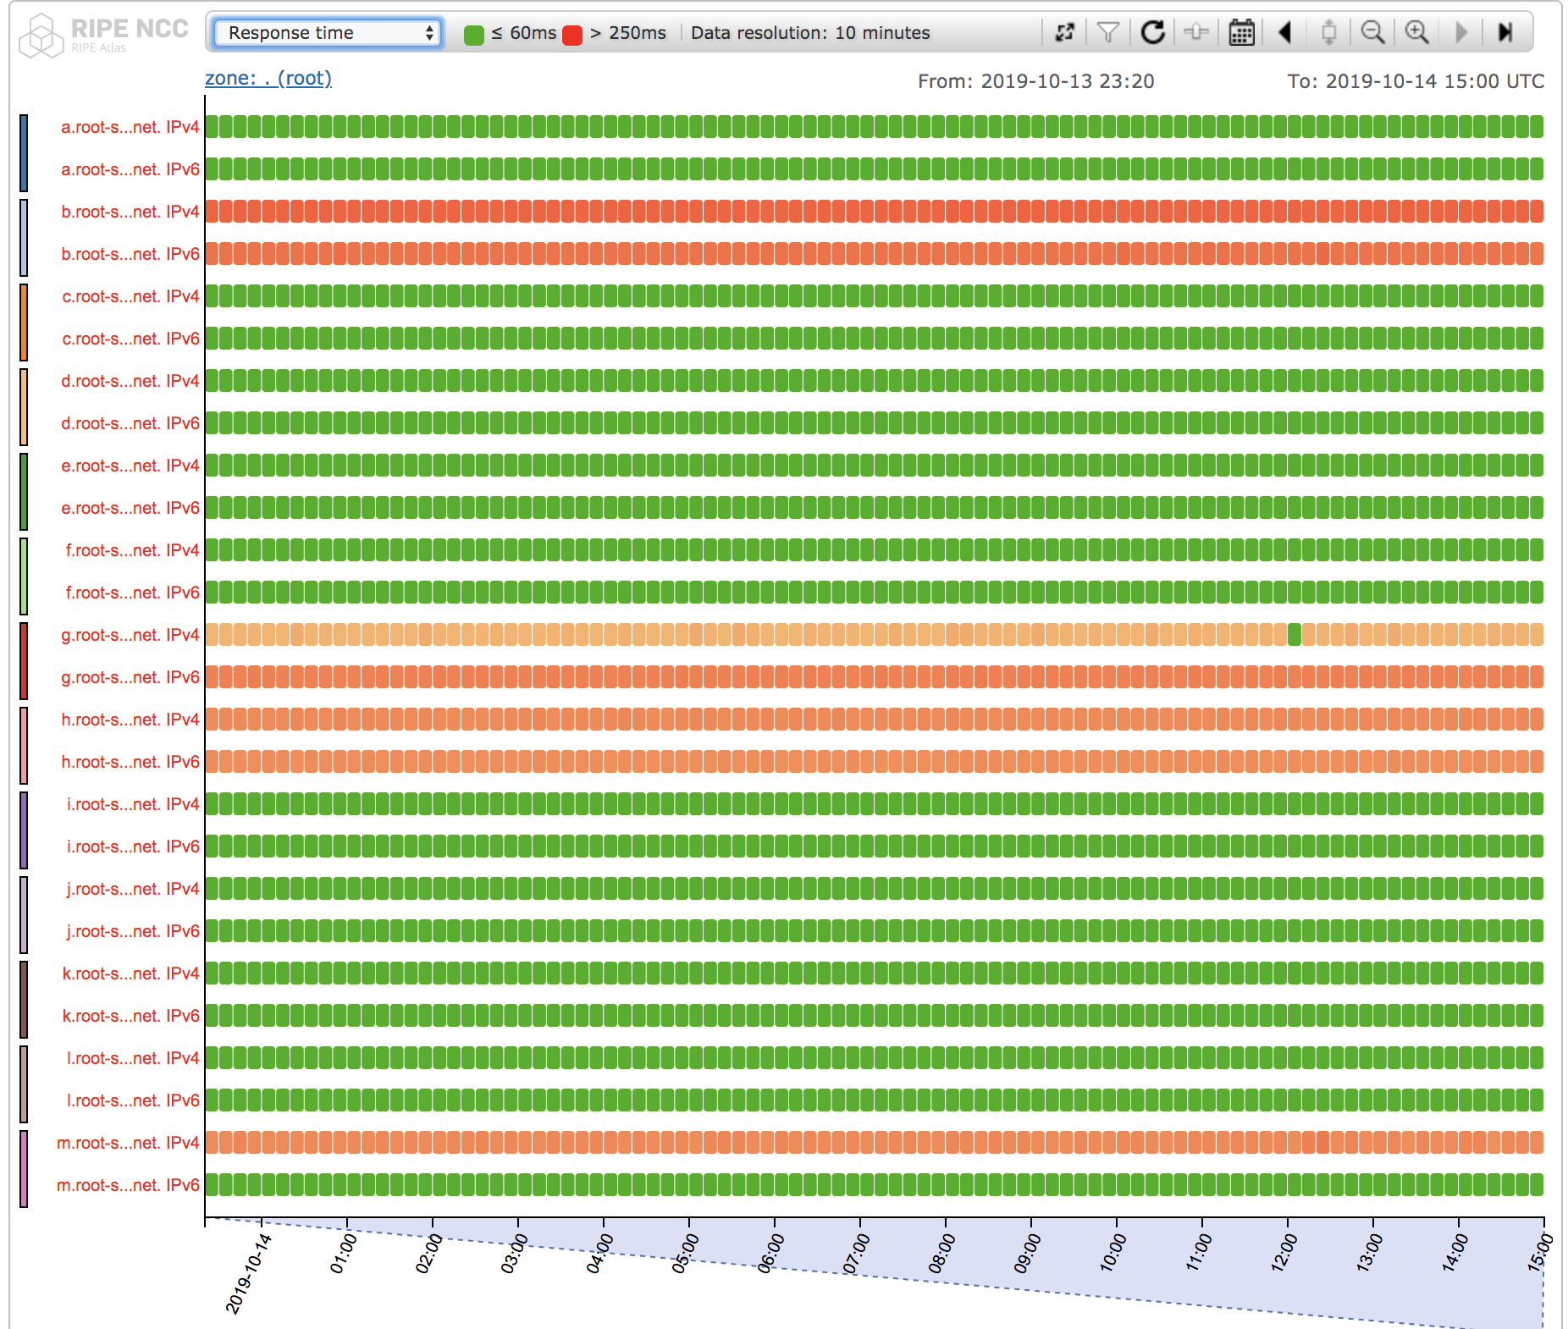
DNSMon ( RIPE )

Slide 21
Questions or suggestions ?

