Slide 1
Tutorial on Reverse DNS: A Primer for Network Engineers
David Huberman
ICANN’s Office of the CTO
RIPE79
14 October 2019

Slide 2
Purpose of this Tutorial
Understand what reverse DNS is and why its useful for network operations
Discover its conventions
Learn about the zone boundaries for IPv4 and IPv6 reverse DNS
Know how to resolve reverse DNS queries and understand the reverse DNS resolution hierarchy
This tutorial does not cover how to delegate reverse DNS authority to a name server for the IP address blocks you operate. Each RIR publishes a really good “How-to Guide” that you can follow. This tutorial will, however, help you understand the principles behind how the RIRs manage reverse DNS.

Slide 3
Tutorial Agenda
1
2
3
Introduction
Resolving DNS Queries: Important Concepts
Resolving Reverse DNS Queries
4
5
More About
Zone Delegations
Some Closing Thoughts
Here’s a place to introduce your sixth agenda item from your talk.
Notes:
This is a stylized agenda slide for your presentation.
To delete a box, if there are too many boxes, click the edge of the box, ensure the entire box is highlighted, then DELETE.
To update the numbers and text, click inside the circle for the numbers or in the box for the text, revise the text.

Slide 4
Introduction

Slide 5
What is Forward DNS?
Forward DNS is what most people are describing when they talk about “the DNS”:
www.icann.org is hosted at the IP address 192.0.32.7
Humans do not want to have to memorize IP addresses
The Domain Name System (DNS) maps semantic names (easily understood by humans) to these IP addresses

Slide 6
The Name Space
DNS database structure is an inverted tree called the name space
Each node has a label
The root node (and only the root node) has a null label
“.”
The root
xn--j6w193g
uk
com
coffee
Top-level
nodes
foo
bar
example
Second-level
nodes
www
www
www
mail
Third-level
nodes
Notes:
Use this slide for diagrams or other graphic elements.

Slide 7
The Domain Name Label
RFC1034 section 3.1:
“When a user needs to type a domain name, the length of each label is omitted and the labels are separated by dots ("."). Since a complete domain name ends with the root label, this leads to a printed form which ends in a dot.”
www.example.com.
mail.bar.uk.
“.”
xn--j6w193g
uk
com
coffee
foo
bar
example
www
www
www
mail

Slide 8
What is Reverse DNS
Reverse DNS is the opposite of forward DNS:
64.78.40.7 maps to ICANN’s mail server out.west.pexch112.icann.org.
In operational networks, reverse DNS has two use cases relevant to network engineers:
Authentication of mail server hostnames
Marking network elements to make tools like traceroute more useful to humans

Slide 9
Resolving DNS Queries: Important Concepts

Slide 10
DNS Resolution Components at a Glance
Recursive Name Server
Authoritative
Name Server
Name
Server
Resolver
DNS query
and response
DNS queries
and responses
Cache
Stub
Resolver
Authoritative
Name Server
API call
Authoritative
Name Server
Notes:
This is a simpler agenda slide, the outline for your presentation.

Slide 11
Hierarchical Resolution
Assuming our resolver caches don’t help us here, let’s look up www.example.com.
We have to resolve “.”
We have to resolve .com
We have to resolve example.com
We have to resolve www.example.com

Slide 12
Resolving “.”
When a recursive resolver boots up, it only has pre-packed config data about the root zone NSset (a root hints file). But that list of NSes may not be current. So the first thing it needs to do is obtain the current root zone NSset.
During start up, it initializes its cache with a priming query. It reads the pre-packaged config data and performs a lookup of the root zone from one of the name servers in the config file.
It receives back a NS RRset for the root node (“.”) from the name server it asked
The priming query fills the resolver’s cache with the NS records for the 13 root name servers [a.root-servers.net. through m.root-servers.net.], as well as some or all of A and AAAA records associated with those

Slide 13
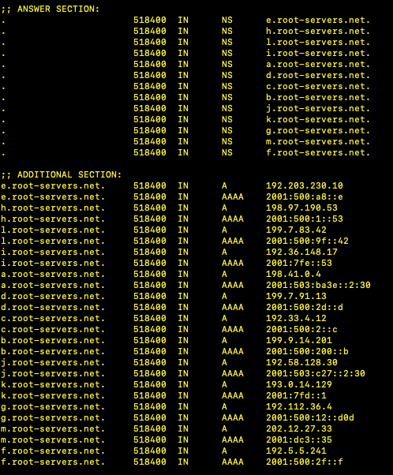
The Root Zone
$ dig . ns

Slide 14
Resolving “.com”
The recursive resolver asks the best* root server to help it resolve www.example.com
The root server answers with the NS RRset for .com, and the resolver fills its cache for .com
* Best is defined subjectively. For some resolver software, it’s the topologically closest server. Other resolver packages might use round robin to randomly choose a root server to query.

Slide 15
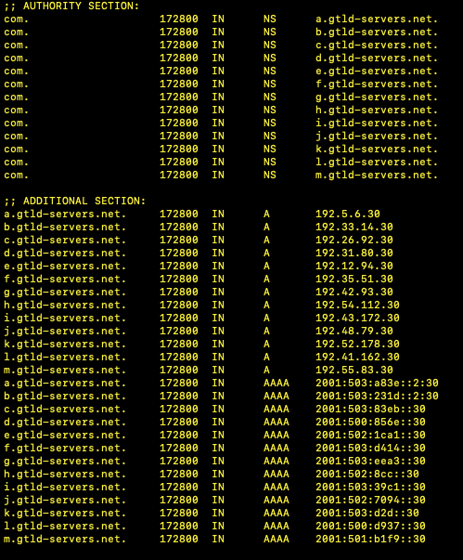
The .com Domain
$ dig +norecurse @L.root-servers.net www.example.com A

Slide 16
Resolving the Rest of Our Query
The resolver asks .com’s authoritative name servers for information about www.example.com
$ dig +norecurse @a.gtld-servers.net www.example.com A
The authoritative name servers for .com respond with the NS records for example.com
The resolver asks example.com’s authoritative name servers for information on www.example.com
$ dig +norecurse @AUTHNS.FOO www.example.com A
The response is the A record for the host www.example.com

Slide 17
Resolution Redux
For our www.example.com resolution:
Ask the root
Ask the TLD auth NS
Ask the domain’s auth NS
Get a final answer
Our query involved three classes of resource records:
NS records
A records
AAAA records

Slide 18
Resolving Reverse DNS Queries

Slide 19
A Practical Use of Reverse DNS: Mail Server Authentication
ICANN’s mail server is out.west.pexch112.icann.org and it is hosted on two IP addresses:
64.78.40.7
64.78.40.10
When mail is delivered via SMTP, the originating mail server presents its credentials to the destination mail server. [“Hi! I’m the mail server out.west.pexch112.icann.org!”]
One of the useful mechanisms to combat spam is to authenticate those credentials, to ensure the mail server credentials are genuine (not forged)
To authenticate the credentials, the destination mail server performs a reverse DNS lookup of the IP address of the originating mail server it is connected to. [“I know that the host 64.78.40.7 is connected to me and is trying to deliver mail to me. It claims it is the mail server out.west.pexch112.icann.org. Let me perform a reverse DNS lookup to see if these two statements reconcile.”]
So how do we do that?

Slide 20
Reverse DNS Resolution: ARPA
The reverse DNS TLD is in the .ARPA TLD
It has an IPv4 version: in-addr.arpa
It has an IPv6 version: ip6.arpa
The reverse domain is appended to the IP address:
64.78.40.7.in-addr.arpa … right?
No!
7.40.78.64.in-addr.arpa.
But why???

Slide 21
… Because it’s Just Like Forward DNS
Forward DNS resolution goes from right to left:
www.example.com.
Conceptually, note that it is also going from least specific to more specific
“.” encompasses the entire name space
.com represents the entire .com TLD
example.com covers the entire example domain
www.example.com is a specific host

Slide 22
Reverse DNS from Least to Most Specific: IPv4
The least specific zone in an IPv4 name space is a /8 zone:
64.in-addr.arpa covers all reverse DNS zones for addresses in 64.0.0.0/8
The next least specific zone in an IPv4 name space is a /16 zone:
78.64.in-addr.arpa covers all reverse DNS zones for addresses in 64.78.0.0/16
As expected, the next zone boundary in IPv4 is for the /24 zone:
40.78.64.in-addr.arpa covers all reverse DNS zones for addresses in 64.78.40.0/24
By the way … notice that we left out all leading .0 octets in our zone names
0.0.0.64.in-addr.arpa is incorrect
64.in-addr.arpa is correct

Slide 23
Zone Boundaries in IPv6
In IPv6 reverse DNS, zone boundaries are defined on the nibble boundary
In classical computer science, a “nibble” is any four-bit aggregation
IPv6 lends itself nicely to nibble boundaries, because it is represented as eight 16-bit quartets:
_ _ _ _: _ _ _ _: _ _ _ _: _ _ _ _: _ _ _ _: _ _ _ _: _ _ _ _: _ _ _ _
Each underscore represents 4-bits:
2 0 0 1: D B 8 0: 0 0 0 0: 0 0 0 0: 0 0 0 0: 0 0 0 0: 0 0 0 0: 0 0 0 0
Each number, therefore, is a nibble boundary, so each number signifies a zone boundary for reverse DNS
Similar to IPv4, we reverse the numbers when defining reverse DNS zones.
0.8.b.d.1.0.0.2.ip6.arpa is the reverse zone for 2001:db8::/32
Leading zeros are important, because the reverse zone’s domain must mathematically match the number of bits it represents

Slide 24
IPv6 Reverse DNS in Practice
Under the current allocation practices agreed upon by IANA and the RIRs, the IANA delegates /12 blocks to each RIR as needed
In 2006, IANA delegated 2400::/12 for APNIC to issue to its customers
APNIC is therefore responsible for the delegation of reverse DNS at the /12 boundary:
0.4.2.ip6.arpa covers all reverse DNS zones for addresses in 2400::/12
APNIC often issues /32s to customers
A customer is delegated reverse DNS at the /32 boundary:
0.8.b.7.0.0.4.2.ip6.arpa covers all reverse DNS zones for addresses in 2400:7b8::/32

Slide 25
Reverse DNS Resolution: the PTR Record
When discussing forward DNS, we were resolving A records and AAAA records, which resolve a domain name to an IP address
In reverse DNS, the RR type is PTR:
“Pointer” record
Resolves a domain name that ends in in-addr.arpa or ip6.arpa that represents an IP address into a fully-qualified domain name
(It requires a FQDN, so the trailing dot is necessary in the zone file!)

Slide 26
Going Back to Our Mail Server Example
ICANN’s mail server is out.west.pexch112.icann.org and it is hosted on two IP addresses:
64.78.40.7
64.78.40.10
We have to query ”.”
We have to query “.arpa”
We have to query “in-addr.arpa”
We have to query “64.in-addr.arpa”
We have to query “78.64.in-addr.arpa”
We have to query “40.78.64.in-addr.arpa”
We have to query “7.40.78.64.in-addr.arpa” or “10.40.78.64.in-addr.arpa”

Slide 27
Going Back to Our Mail Server Example
ICANN’s mail server is out.west.pexch112.icann.org and it is hosted on two IP addresses:
64.78.40.7
64.78.40.10
We have to query ”.”
We have to query “.arpa” ← not true
We have to query “in-addr.arpa”
We have to query “64.in-addr.arpa”
We have to query “78.64.in-addr.arpa” ← not true
We have to query “40.78.64.in-addr.arpa”
We have to query “7.40.78.64.in-addr.arpa” or “10.40.78.64.in-addr.arpa”

Slide 28
The Root Zone
$ dig +norecurse @L.root-servers.net . ns

Slide 29
The in-addr.arpa Domain
$ dig +norecurse @L.root-servers.net in-addr.arpa ns

Slide 30
The 64.in-addr.arpa Domain
$ dig +norecurse @a.in-addr-arpa-servers.arpa 64.in-addr.arpa ns

Slide 31
The 40.78.64.in-addr.arpa Domain
$ dig +norecurse @U.arin.net 40.78.64.in-addr.arpa ns

Slide 32
The PTR Response for Our Mail Relay
$ dig +norecurse @ns2.intermedia.net 7.40.78.64.in-addr.arpa PTR

Slide 33
More About Zone Delegations

Slide 34
Your Delegations and Your RIR
Reminder:
In IPv4, zones are delegated at either the /8, the /16, or the /24 boundary
In IPv6, zones are delegated on the nibble boundary

Slide 35
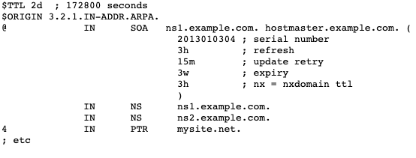
You are the Registrant of a /24
If you have a /24, you configure a reverse domain in your zone files for the /24

Slide 36
You are the Registrant of a /20
If you have a /20, you configure sixteen reverse domains – one for each /24 - in your zone files

Slide 37
Delegations Smaller than a /16
/24 = 1 reverse domain
/23 = 2 reverse domains
/22 = 4 reverse domains
[. . .]
/18 = 64 reverse domains
/17 = 128 reverse domains

Slide 38
Your Delegation of a /16 (or larger)
If you are the registrant of a /16, simply insert a new level of hierarchy:
Configure a /16 reverse domain with authoritative NSes
Then configure the individual /24 reverse domain zone files
If you are the registrant of a /15, configure two /16 reverse domains, and then configure two sets of 256 /24 reverse domain zone files

Slide 39
IPv6 Delegations
A /32 is the default size for LIRs. It acts just like a /16 in IPv4. You answer for the /32, then define individual reverse domains as necessary – respecting the nibble boundaries.
If you have a /48 or something smaller, the RIR will respond to the /32, and delegate the individual /48s or /44s (etc.) to your name servers

Slide 40
Fun Fact: Very Large Address Blocks
In the early days of IPv4, Jon Postel issued /8s to large companies for their networks, which were larger than 256 subnets. Some companies still have /8s.
We can envision a possible IPv6 network that is huge – that might use something as large as a /12
For these types of fundamentally large address blocks, you configure your zone files just like you would in our previous examples – hierarchy at each zone boundary. But DNS resolution actually bypasses your RIR. ARPA delegates to IANA, which delegates directly to your authoritative NSes.

Slide 41
CNAMES and Really Small Zones
Delegation boundaries are easy to respect as an LIR. But what about your customers who need reverse DNS for small address blocks (e.g. a /28 in IPv4)?
There can only be one delegation by the RIR for each /24
To overcome this restriction, we use the CANONICAL NAME (CNAME) RR type
“An alias name for a host. Causes redirection for a single RR at the owner-name.”
www.RipeIsAwesome.net CNAME www.ripe.net
Importantly, the existence of a CNAME for a particular domain causes a new DNS lookup
That is what allows us to get around the “one delegation” rule
In reverse DNS, RFC2317 was written to define how to use CNAME RRs in reverse DNS zone files to handle address blocks smaller than a /24

Slide 42
CNAME Resolution Path
Example network of 1.2.3.0/24
3.2.1.in-addr.arpa. has NS1.FOO.BAR as an authoritative name server
We want to delegate the /28 for 1.2.3.128 through 1.2.3.143 to a different set of authoritative name servers
In our zone snippet for 3.2.1.in-addr.arpa. we use CNAMES

Slide 43
CNAME Resolution Path
Example network of 1.2.3.0/24:
Query the .arpa zone
Query the X.in-addr.arpa. zone (the /8)
Query the Z.Y.X.in-addr.arpa. zone (the /24)
Resolve the CNAME, which begins a new resolution path at the specified NSes

Slide 44
Some Closing Thoughts

Slide 45
Traceroute
Mail server authentication is a big use of rDNS
The other really useful implementation of rDNS is in tagging network elements for troubleshooting.
But this is a good example of rDNS behavior in the real world. It’s out-of-date.

Slide 46
Out-of-date is Common
If you have a fully integrated OSS or IPAM managing your IP address assignments and all your rDNS, then you likely have good records.
But many (most?) networks do not enjoy such tooling, and the first thing we see go out-of-date are the PTR records.
IP addresses change which customers they are assigned to
IP address assignment size changes (think: CNAME zone snippets)
Changes to network elements (re-architecture) and someone forgets to update all the PTR records. Because that’s not a normal part of a network engineer’s day-to-day!
Another general takeaway: so much of the rDNS tree is unpopulated. If you think about all the traceroutes you do, you see lots of hops have no labels. This is common. The rDNS is often not a reliable source of information about a host.

Slide 47
Go Read RFC8501
Lee Howard published a very useful RFC:
“Reverse DNS in IPv6 for Internet Service Providers”
Includes a sections on Dynamic DNS and negative responses

Slide 48
RIR How-to Guides
Each of the RIRs publishes a reverse DNS “how-to guide” which describes the procedures you need to follow to delegate reverse zones.
Hopefully you now better understand how things work in rDNS and can now ask very good questions of the RIR hostmasters!

